Slide 1
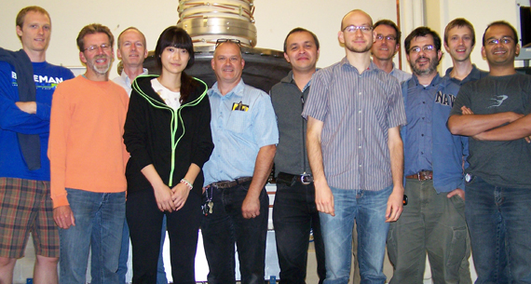
Physics and technology of high-brightness high-power photoinjectors for beam coolers and electron ion colliders
PI: Ivan Bazarov
Cornell University
Cornell High-Brightness Beam Group

Slide 2
Outline
Injector Layout and Modeling
High Charge Measurments (Q ≤ 2 nC)
High Current Running
Physics of Ion Clearing

Slide 3
Relevance
Address major outstanding technological and beam physics issues of critical importance to high intensity sources as required by the EIC
The landscape of successfully operating high current photoinjectors is extremely modest, none of them have demonstrated parameters as required for EIC (coolers or collider)

Slide 4
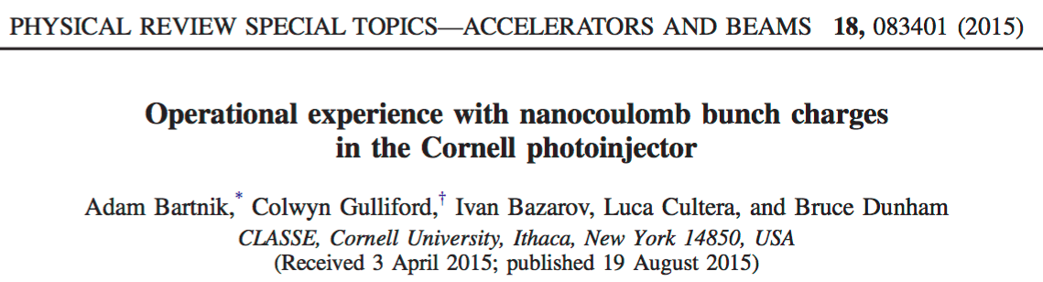

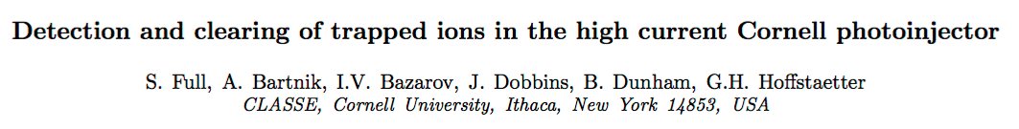
Project Goals
1 & 2 nC bunch low-emittance operation from DC gun injector (done)
High average current running @ high charge (progress made)
Physics of ion trapping & clearing (good progress made)

Slide 5
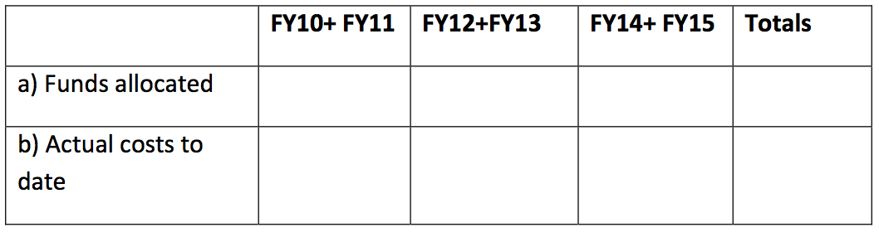
Budget
340k$
340k$

Slide 6
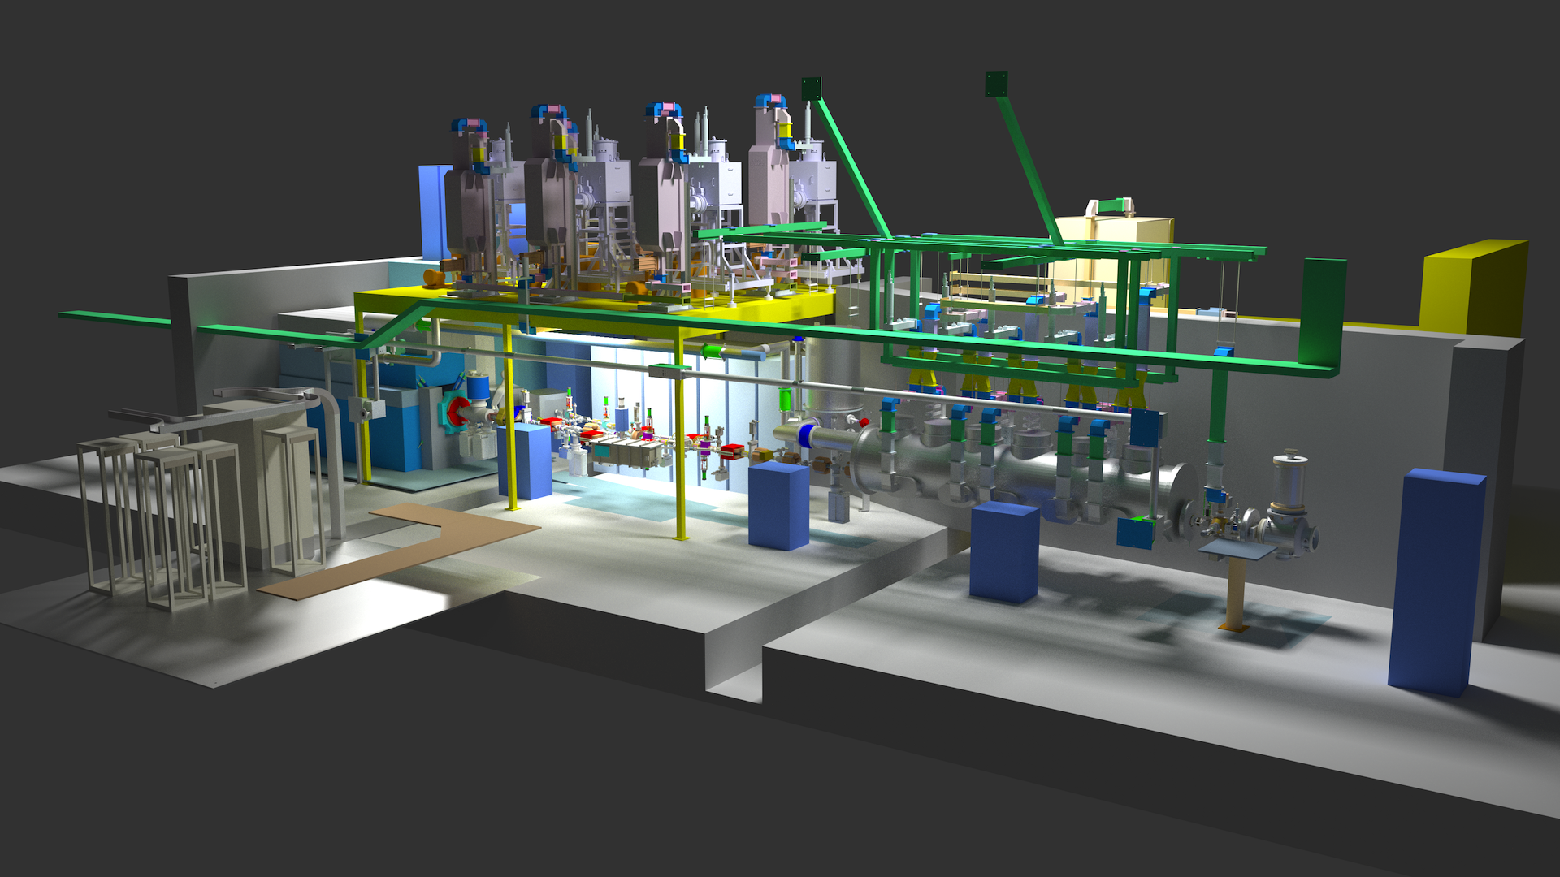
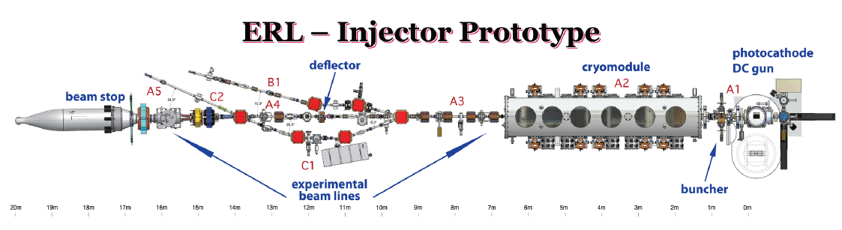
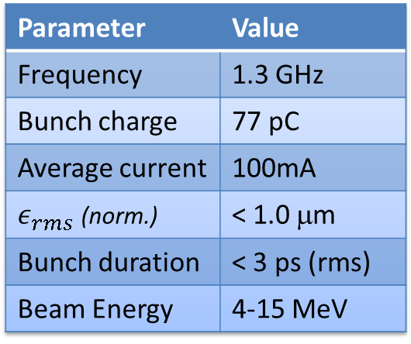
Original Design
Original design: ERL injector
Moderate charge
High current
Note: merger section (B1)
Injector Specification
Parameter | Value
Frequency | 1.3 GHz
Bunch charge | 77 pC
Average current | 100mA
 | < 1.0 μm
Bunch duration | < 3 ps (rms)
Beam Energy | 4-15 MeV

Slide 7
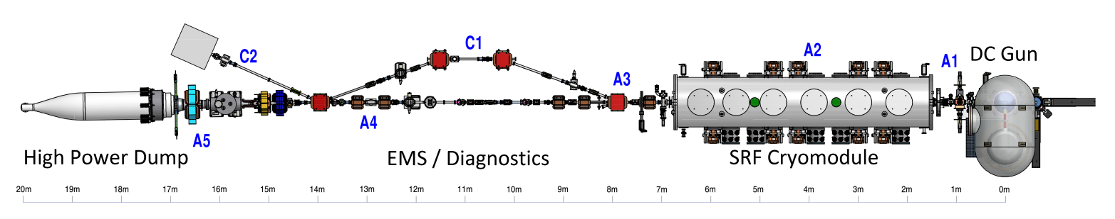
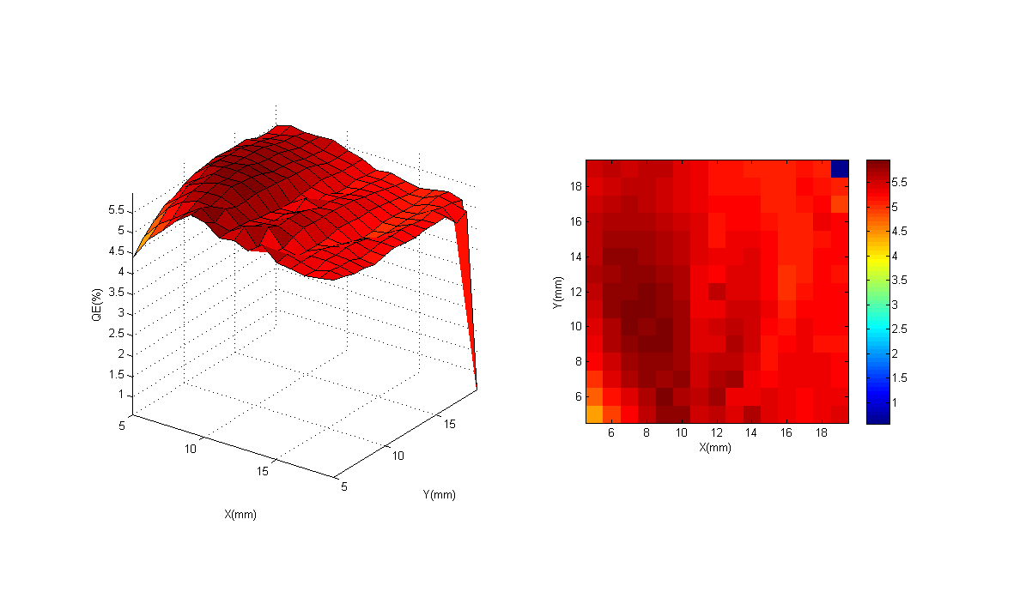
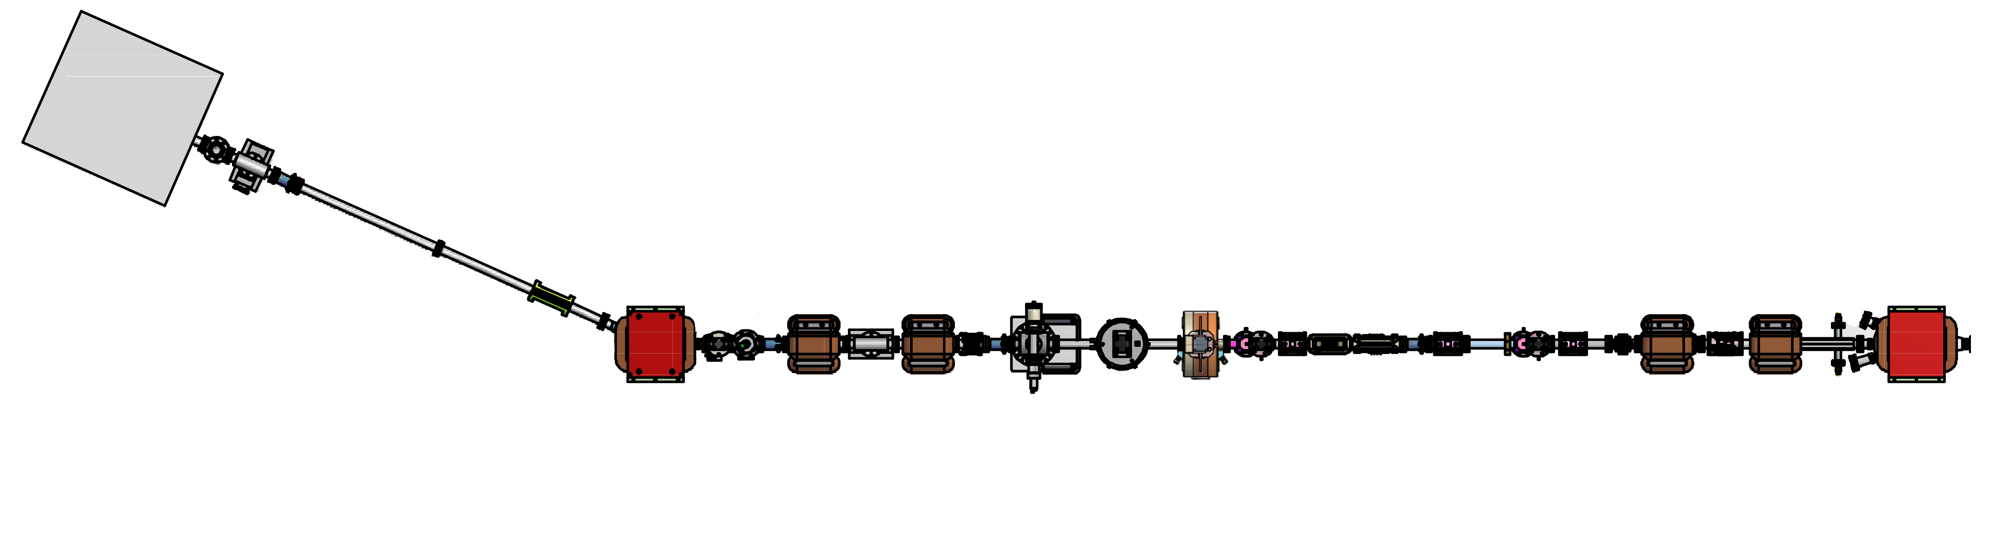
Injector Layout
6 Dimensional Phase Space Diagnostics + High Power Beam Dump + Chicane (Compton Scattering)
Short SRF Linac
5 – 15 MeV
395 kV DC Gun +
Bunching/Focusing
Emittance Measurement System
Superconducting
RF Cavities (niobium)
395 kV DC Gun
NaKSb: MTE = 140 meV, QE roughly 5%
2nd Scanner
Magnet Pair
1st Scanner
Magnet Pair
Faraday Cup
Faraday Cup
+ Viewscreen
50 MHz
520 nm
Viewscreen
Deflecting
Cavity
2nd Slit
1st Slit

Slide 8
Laser Shaping
Transversely: clip Gaussian laser profile at a given intensity
fraction (typically 50%)
Longitudinally: Birefringent Crystals for pulse stacking:

Slide 9
3D GPT Injector Model
Code of choice: General Particle Tracer
Real Laser CCD Image
3D Space Charge algorithm
Load/Create Realistic Particle Distributions
Overlap field maps and position them in 3D space
Customizable (define new beamline elements)
Includes 3D complex RF Field Maps w/coupler fields
Used realistic field maps for all beam line elements
Customized quadrupole and dipole elements with fields computed
from an on-axis field map

Slide 10
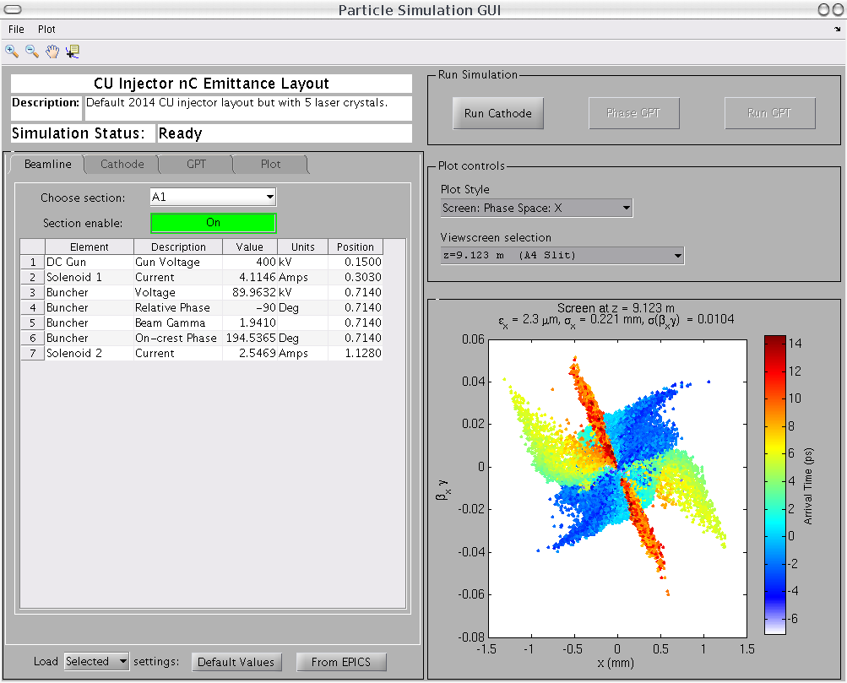
Integration into the Control System
GPT Virtual Accelerator GUI: load machine settings, load optimizer settings,
save/restore, independently simulate machine in (near) real time
Save / Load
from file or optimizer
Create Particles
Run GPT
Control Tabs
Beamline
Settings
Plotting +
Analysis
Load from
EPICS

Slide 11
Previous results
Emittance measurements¹ (merger section, 7 MeV)
350 kV Gun Voltage
Met requirements for ERL
Bunch charge | Bunch length | Horz Emit. (100%) | Vert Emit. (100%)
19 pC | 2.1 ps | 0.33 μm | 0.20 μm
77 pC | 3.0 ps | 0.69 μm | 0.40 μm
Asymmetry Due to the Merger?
High current operation^{2,3} (straight section, 4 MeV)
Up to 75 mA peak, reliable operation at 65 mA
> 60 hour cathode lifetime at 65 mA (NaKSb)
250 kV Gun Voltage
^{1.} Gulliford el al., Phys. Rev. ST Accel. Beams 16, 073401 – 2013
^{2.} Cultrera el al., Appl. Phys. Lett. 103, 103504 (2013)
^{3.} Dunham el al., Appl. Phys. Lett. 102, 034105 (2013)

Slide 12
Primary Question
Can the injector provide similar performance in parameter ranges appropriate for the EIC?
  Much higher bunch charges (up to 2 nC)
  More relaxed emittance requirements
  No requirement for short bunch length
  High current (up to 50 mA @ 50 MHz repetition rate, 1 nC)
    Requires running off center on cathode

Slide 13
Intermediate Charge (for LCLS-II)*
Met spec at 20/100/300 pC charges
Same SRF settings for all charges
Q (pC) | I_{peak} Target (A) | I_{peak} (A) | ε_{n} Target (95%, μm) | ε_{n} (95%, μm) | ε_{n,th} /ε_{n}
20 | 5 | 5 | 0.25 | H: 0.18, V: 0.19 | 58%
100 | 10 | 11.5 | 0.40 | H: 0.32, V: 0.30 | 80%
300 | 30 | 32 | 0.60 | H: 0.62, V: 0.60 | 70%
C. Gulliford, Appl. Phys. Lett. 106 (2015) 094101
*These measurements were supported by SLAC

Slide 14
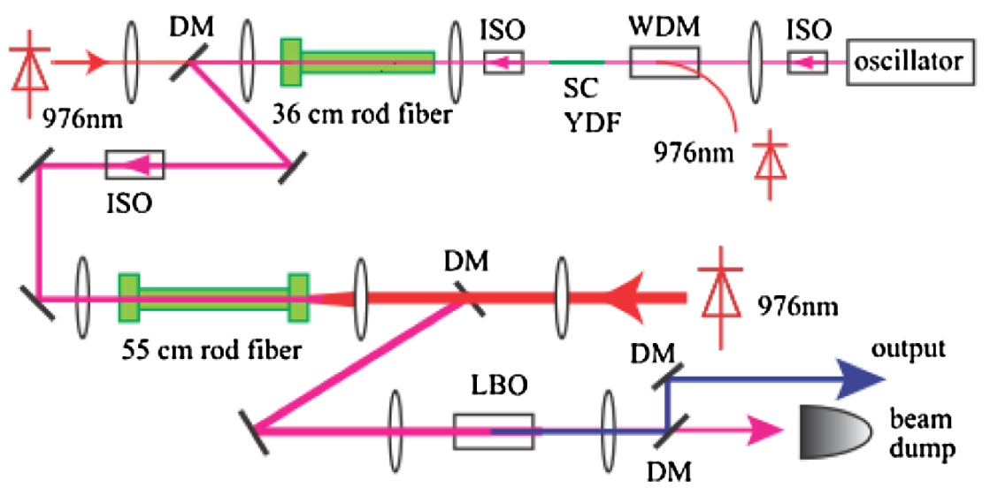
Laser upgrade for nC bunches
Drive laser was incapable of reaching pulse energies needed for nC bunches
Upgraded using Yb-doped rod amplifiers
  Capable of 150 W average power (IR) and 1 MW peak power
  Limited to 50 W due to damage threshold of downstream optics
Zhi Zhao, et. al, JOSA B, 31, 33-37 (2014)

Slide 15
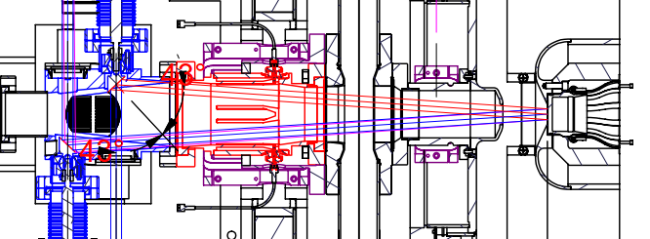
Machine tuning
Use nearly the same SRF settings as 20-300 pC measurements
Buncher is held fixed from 300 pC setting (already at max field, without more processing)
Anode clips laser light more than 9 mm from cathode center
  To avoid central 3 mm, laser size must be <6 mm

Slide 16
Laser Characterization
Laser size scales as
Need D > 6 mm for 1nC
Lengthen pulse:
  8 ps -> 25 ps
Optimizer chooses D = 5 mm
For 2 nC, D = 7 mm
In practice, need D = 8.8 mm
to get enough charge

Slide 17
Results
1 nC: 1.6 μm, 2 nC: 4.4 μm (95%)
1 nC: 1.6 μm, 2 nC: 4.0 μm (95%)
A. Bartnik et al., PRSTAB 18 (2015) 083401

Slide 18
Effects from Laser Shape
Ideal Shape
Measured Shape

Slide 19
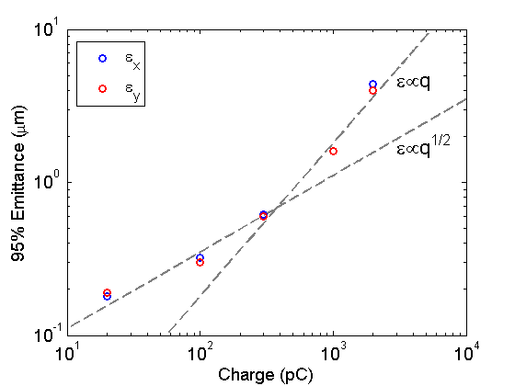
Emittance Summary
Trend becomes more linear around 300 pC…
Q (pC) | Peak current (A) | Emittance (95%, μm)
20 | 5 | H: 0.18 V: 0.19
100 | 11.5 | H: 0.32 V: 0.30
300 | 32 | H: 0.62 V: 0.60
1000 | 50 | H: 1.6 V: 1.6
2000 | 56 | H: 4.4 V: 4.0

Slide 20
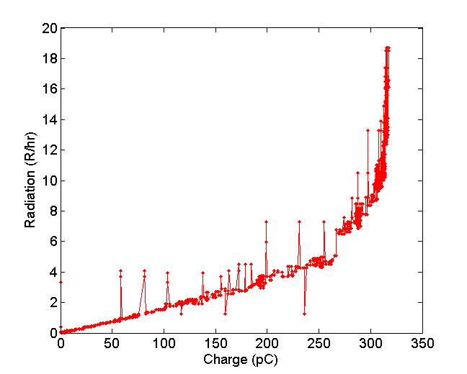
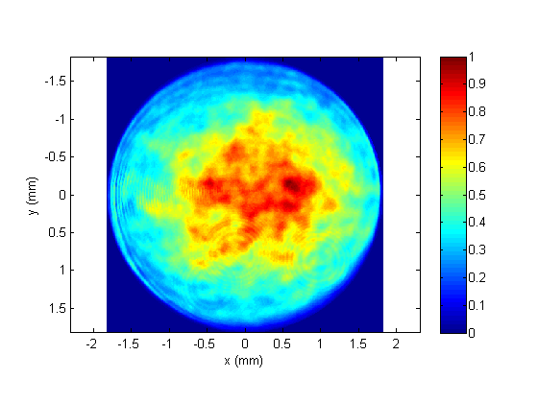
High current operation (FY14)
Would like a 5 mm diameter active area cathode, offset from gun center
Only off-center cathode available had a roughly 3.5 mm active area
See dramatic increase in radiation around 320 pC
  Made laser size bigger: same problem at 375 pC
  In simulation, begin to lose particles at cathode around 400 pC
Laser profile during high current
Space charge limit?

Slide 21
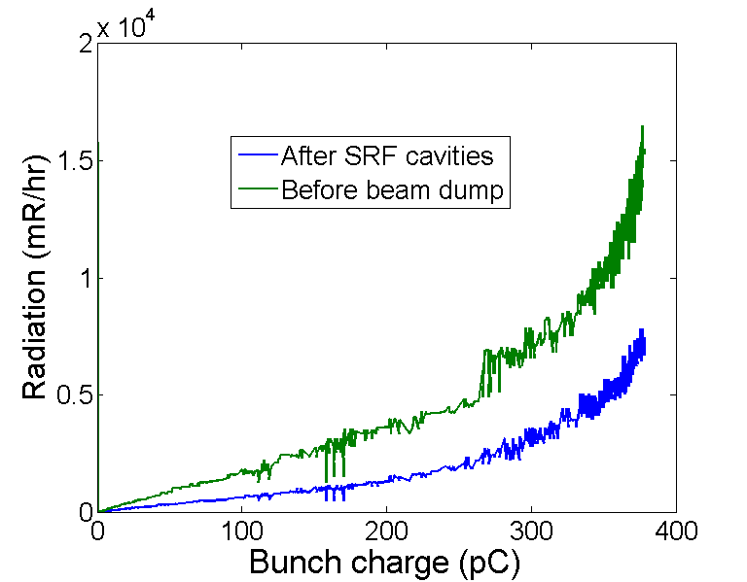
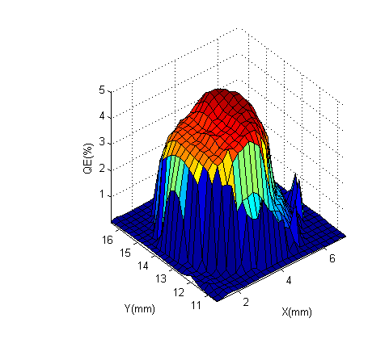
High current operation (FY14)
Another attempt – still more than x2 to go
Further attemps plagued by field emission from photocathode
Cathode used for High Current Operation
Active area offset ~ 5 mm from gun center
Active area width ~ 3 mm diameter
About 20 mA

Slide 22
High current operation plans (FY15)
Improvements planned to go beyond 20 mA
  Redo the longitudinal laser shaping, so that we can employ longer pulses to minimize the space charge
  Realize the larger active area (off-center) photocathodes, which will be field-emission free.

Slide 23
Ion trapping is unavoidable in ERLs/high rep rate linacs.
Ion Problems at High Current
During CW, high repetition rate operation ions cannot escape between bunches
  Anecdotally we know ions are trapped in the photoinjector:
    High beam power (> 1 mA) prevents traditional measurements
    But beam-ion interactions generate bremsstrahlung
    Ion clearing electrodes reduced radiation by >50% when approaching 70 mA.
Ex. synchrotron/ring
Ions can
drift out
Ex. linac at low rep rate/low current
Ex. CW linac at high rep rate/high current

Slide 24
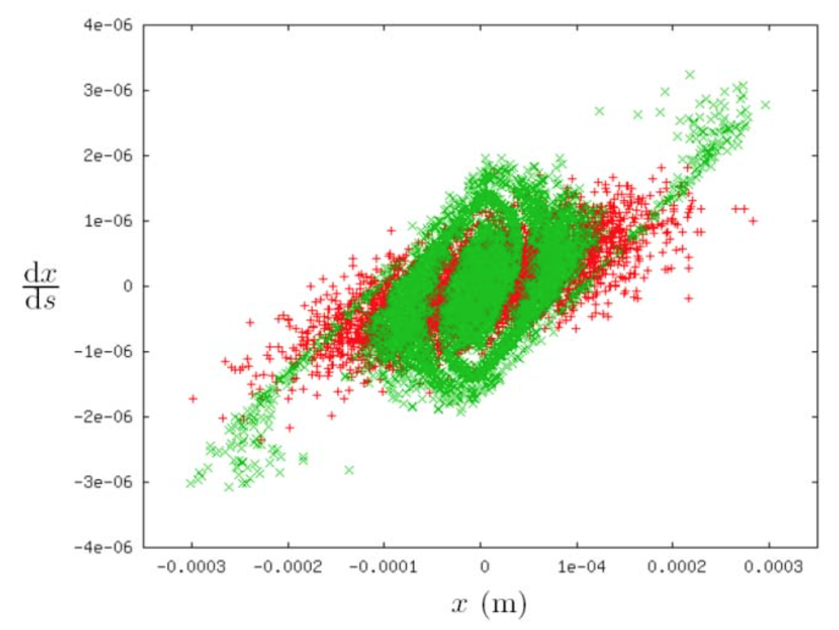
Detrimental Effects of ions
Ion clearing methods are required for stable beam operation above 20 mA.
Without clearing methods, the machine will trip every 15 – 75 mins.
Ions can also cause:
  Emittance growth
  Beam halo/losses
  Incoherent tune shifts/spread
  Betatron phase errors (ion focusing)
  Charge neutralization (e.g. operational drifts/machine safety)
  Beam instabilities (ex. Fast Ion Instability)
Simulated Phase space in Cornell ERL design
Green – After traversing 200 m ion field
Red – Normal operation
G.H. Hoffstaetter, C. Spethmann , Phys. Rev. ST AB, Volume 11, 014001 (2008)
Notes:
Not clear low repetition rate measurements will apply at high currents due to ions
Red – No ions, Green - Ions

Slide 25
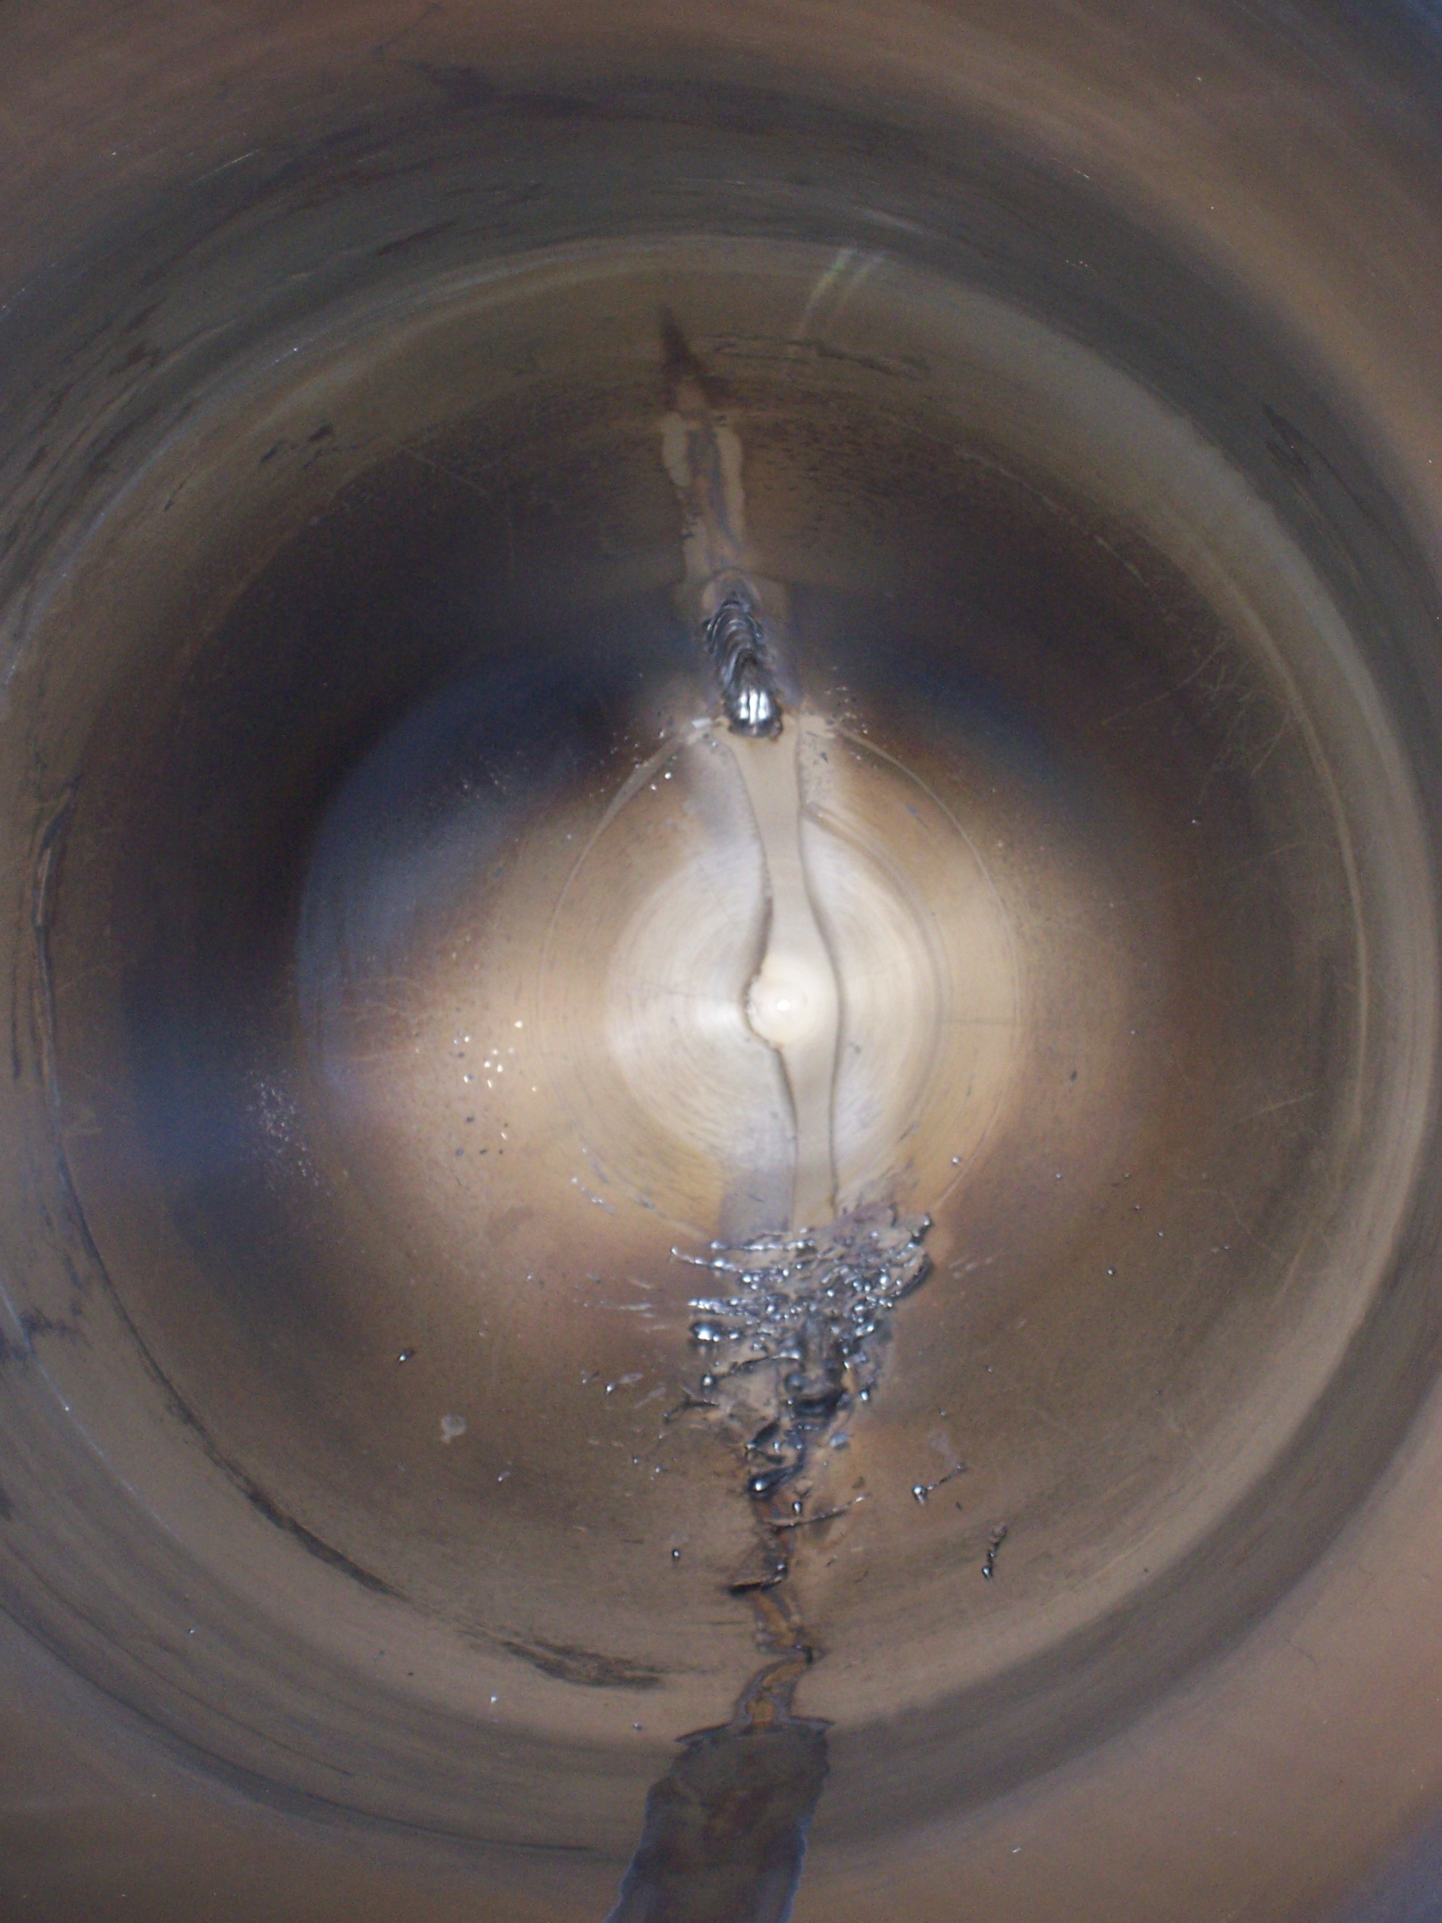
Measurements at High Power
  We’re one of the first to explore this regime experimentally
  Ions have been studied extensively using simulations, but experimental data is rare.
We can’t measure beam directly
  Interceptive diagnostics melt above 1 mA
  No synchrotron/diffraction radiation (low energy linac)
  New fast wire scanner wasn’t available
We look for ions instead
We used 3 diagnostics in FY14
  BPM + spectrum analyzer
  Ion clearing electrode + picoammeter
  Radiation monitors
Melted beam dump after raster failure.

Slide 26
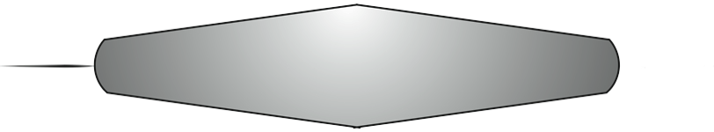
Flying Wire
Operating principle
Detection
Photomultiplier Sensor
Vacuum flange
Large gear
Small gear
(behind blade)
ElectronBeam
X-rays
Carbon
Wire
~ 34 μm thick
~ 2-3 cm long
Scintillator
Blade
To hold the wire
Scale: 35cm / 14”

Slide 27
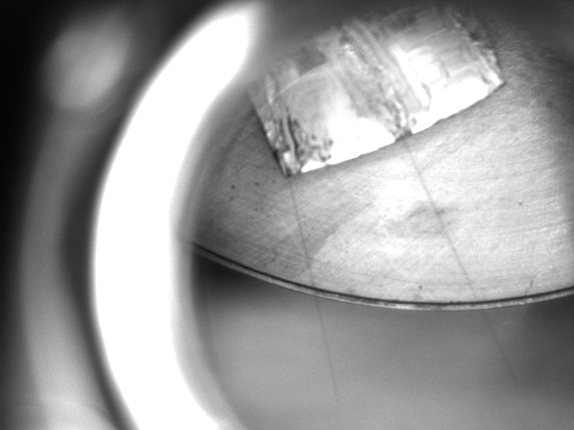
Flying Wire
sole wire remaining
FY14 – the wire kept breaking, problem now identified
Poor tensile strength of carbon wires
Working to fix for FY15

Slide 28
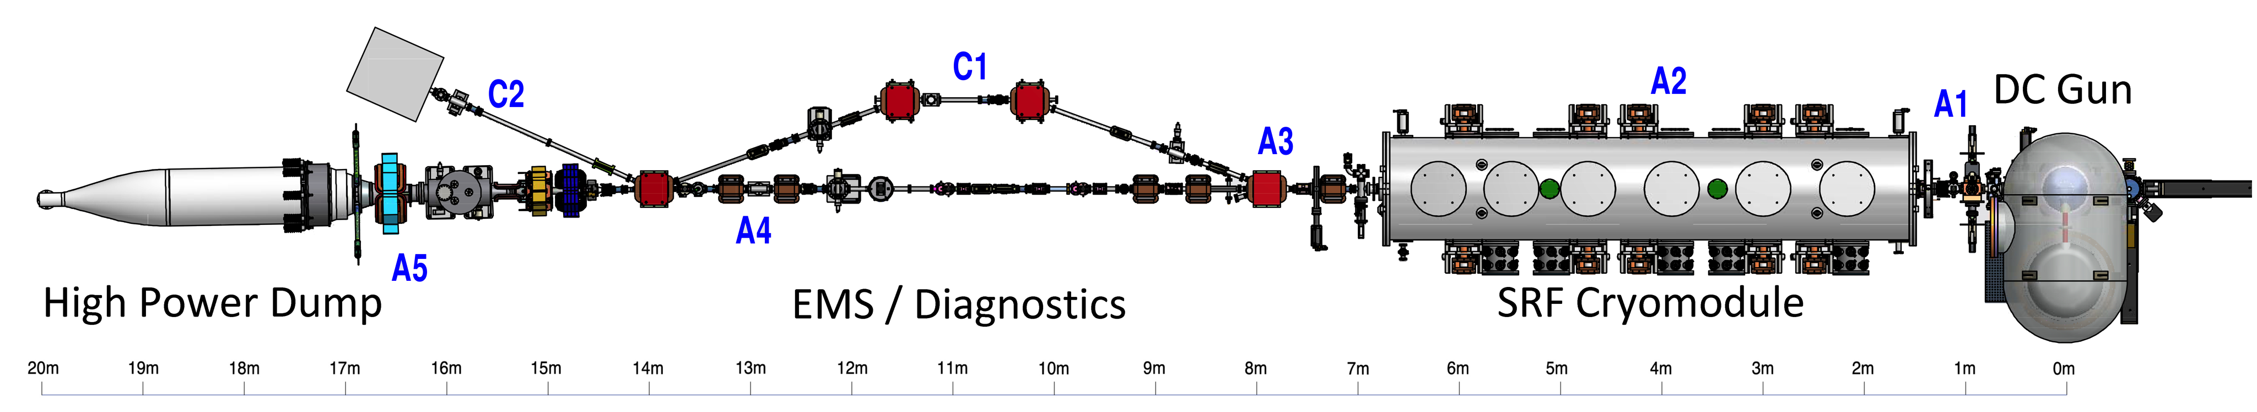
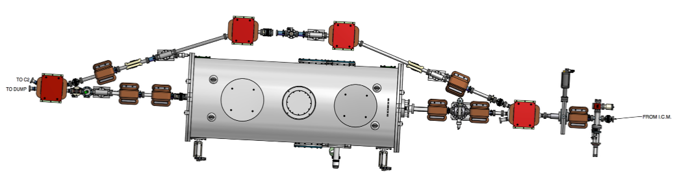
Experimental Setup for Ions
BPM + Spectrum Analyzer
Beam
2 m
Ion clearing electrode + picoammeter
Gas leak
(N₂, Ar, Kr)
Superconducting
RF Cavity
(HTC - Horizontal test cryomodule)
Present only during beam shaking experiments

Slide 29
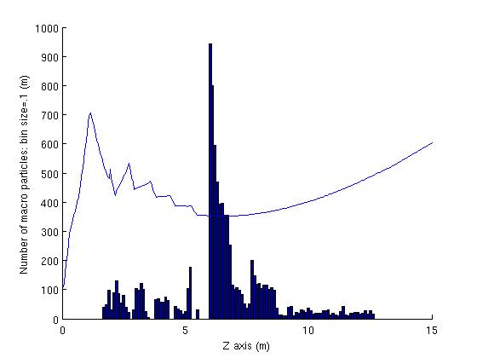
Some Highlights of the Results
Developed ion-electron tracking simulation software.
It showed that ions drift longitudinally, and accumulate at beam size minima, as expected.
Useful for deciding locations of clearing electrodes.
ions evolve in time
E-beam envelope

Slide 30
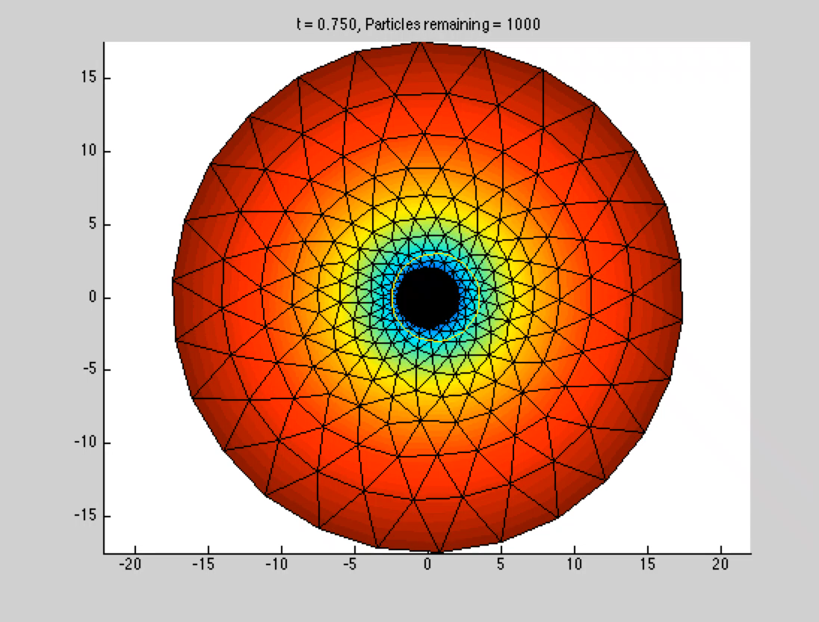
Movie of beam shaking using a Poisson solver
Clearing by Resonant Shaking
x (mm)

Slide 31
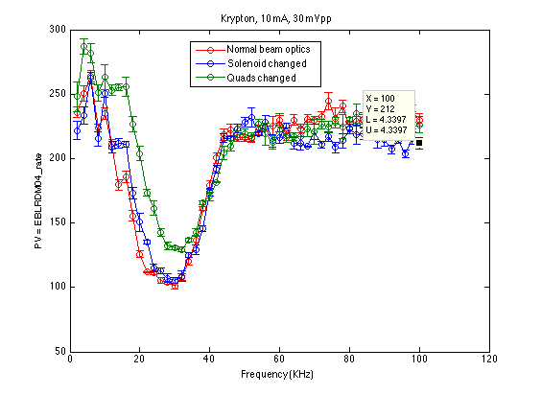
Frequency scales correctly with beam current, ion mass, but not beam size.
Resonant Frequency Dependence
Changing the beam size by over a factor of 3 did NOT change the resonance frequency… Still a mystery

Slide 32
Measured the ion current removed by the clearing electrode
Clearing electrode measurements
Can accurately predict required voltages, by considering when clearing field exceeds beam’s peak field.
Can use the max measured current to estimate the longitudinal range of the clearing electrode (useful for deployment).
τ_{cr} | Creation time
L_{cr} | Creation region

Slide 33
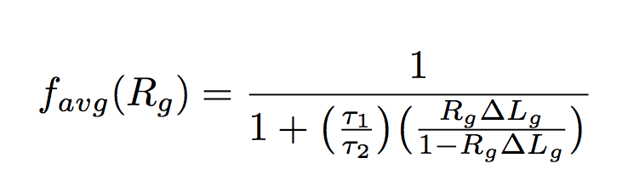
We measured the residual trapped ion current while employing bunch gaps.
Bunch gap clearing
Our model: The ion density…
1) Increases via collision ionization while the beam is on.
2) Decays exponentially during the bunch gaps.
Lines are the average remaining ion fraction calculated from our model.
Notes:
Pockels cell to reject laser pulses
Two interesting results come from this measurement

Slide 34

Summary of Ions so far
Established ion presence & its correlation to beam losses (radiation)
Tried different scenarios of ion clearing & initial look at their (limited) efficiency
  Resonant shaking
  Missing bunches/clearing gaps
  Clearing electrodes
Large scale machines likely require a combination of the above
Big remaining issue: seeming insensitivity of the ion resonant frequency to the transverse electron beam size (to be addressed in FY15)
S. Full et al., Detection and clearing of trapped ions in the high current Cornell photoinjector, arXiv:1508.00923

