Slide 1
Investigation of Fundamental Limits to Beam Brightness Available From Photoinjectors
Ivan Bazarov
Cornell University

Slide 2
Outline
Project Significance
Goals & Status
Accomplishments
National and International Impact
Future Steps

Slide 3
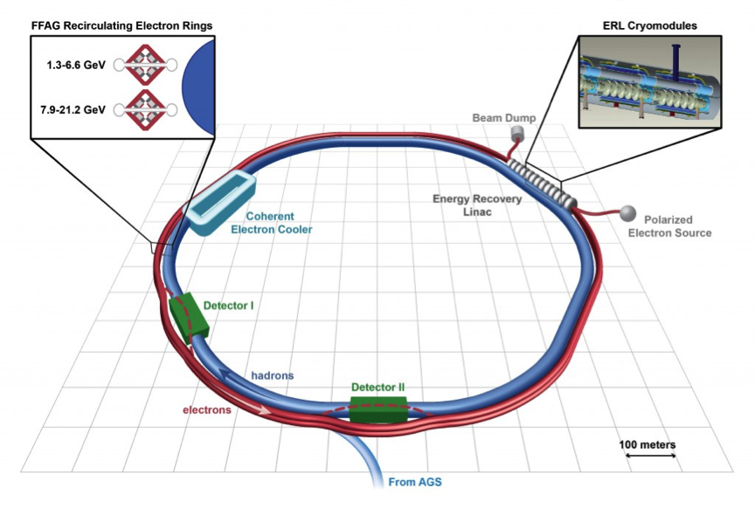
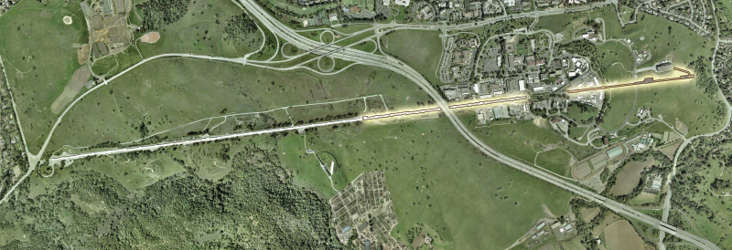
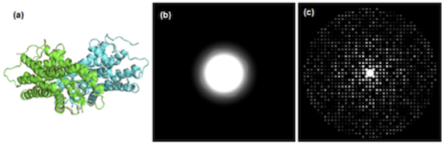
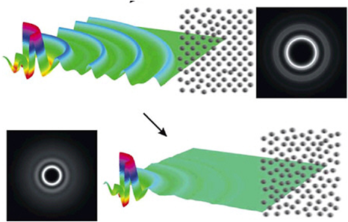
Project Significance
What is Physical Limit to Beam Brightness?
-E_{z}
Big linear accelerators
electron beam
EIC
LCLS-II
electrons
Photocathode
Small MTE has big impact on accelerators
Laser
Beam brightness
Lab scale ultrafast electron diffraction
Coherence length

Slide 4
Goals
Understand fundamental physics and technology limits to high brightness beam production in photoinjectors;
Cathode research:
  Photoemission physics modeling & measurements of intrinsic mean transverse energy (MTE), response time, and quantum efficiency (QE) of non-metal photocathodes (QE ≥ 5%);
  Explore and engineer novel photocathode materials in real-life accelerator conditions of a high average current photoinjector
Beam dynamics:
  Realization of the brightness limit from the photoinjector as set by space charge and the photocathode mean transverse energy spread
  Among the physics issues being tackled: adaptive laser shaping for lowest emittance

Slide 5
Project Status
Project start/end: Apr 2010/2015
Output: 19 journal papers, 12 conference proceedings, 2 book chapters
All milestones/goals met
Enabled many advances: e.g. world-record brightness photoinjector, smallest emittance cathodes to date, longest lifetime @ high currents, etc.

Slide 6
Some of the Highlights
Photocathode physics modeling
Ultralow emittance cathode diagnostics
High performance photocathodes
Laser shaping for low emittance production
Cornell Photoinjector Record Beam Performance

Slide 7
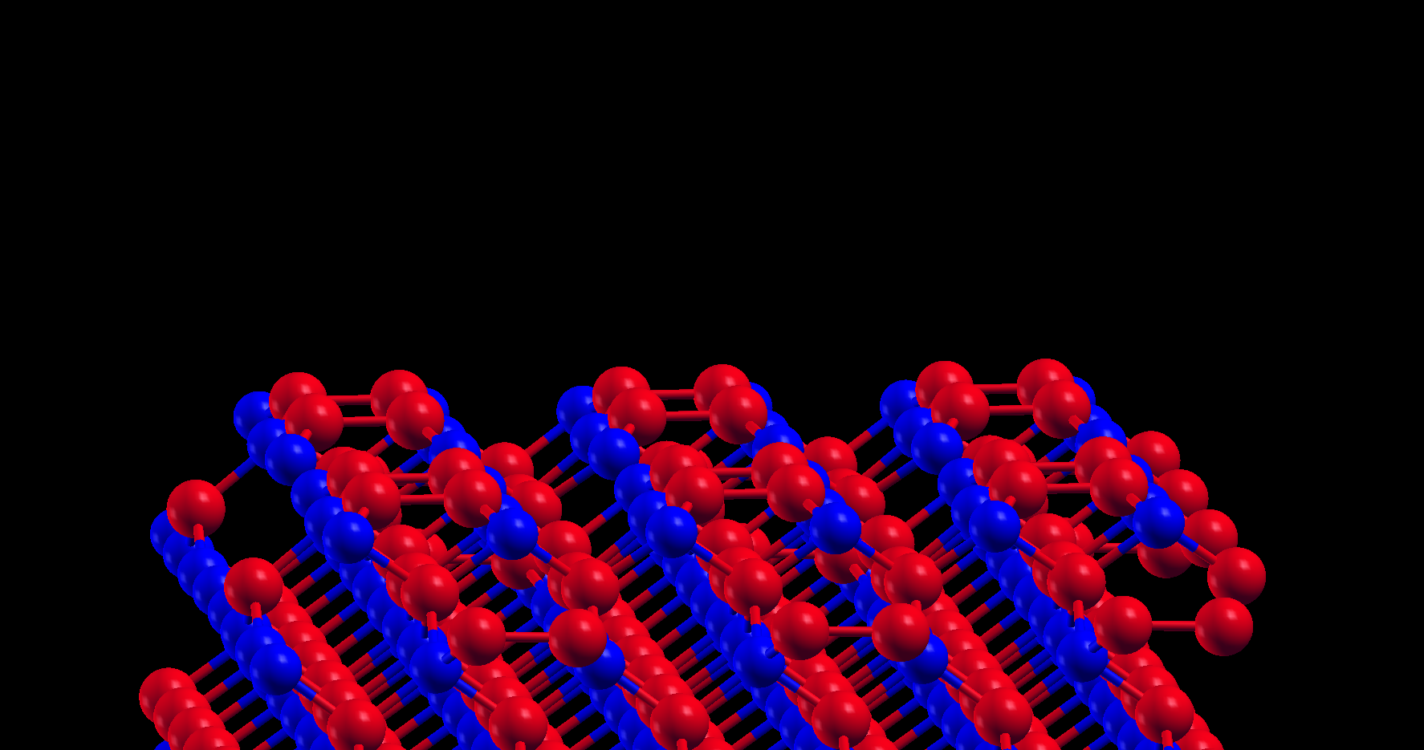
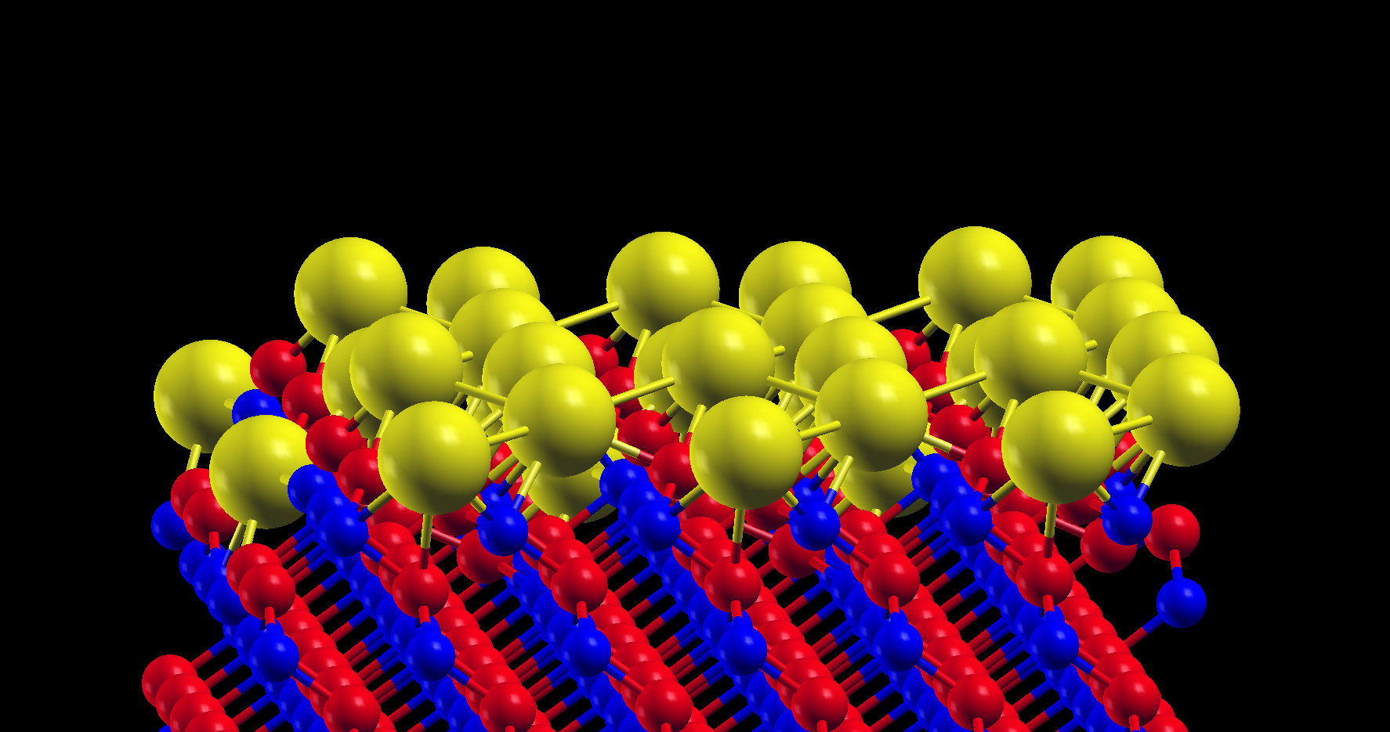
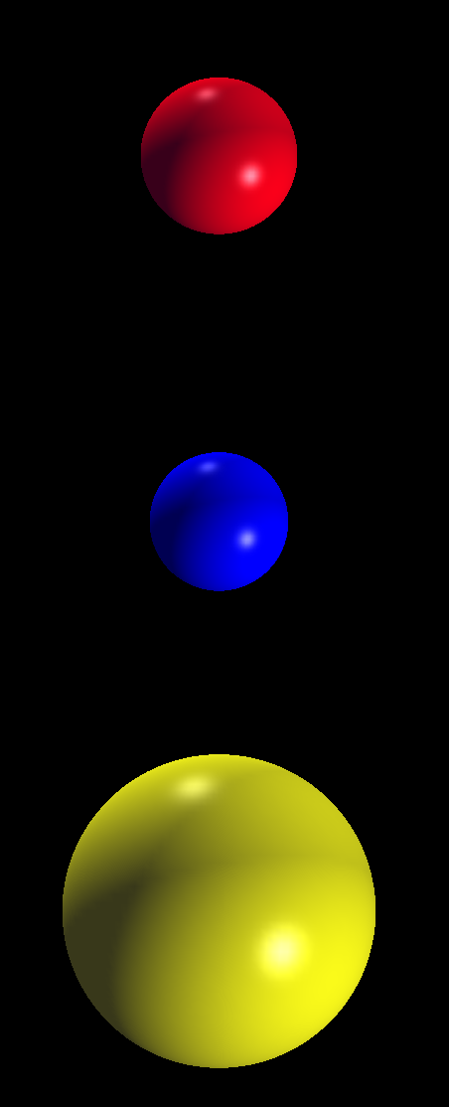
(1) Cathode modeling of III-V’s
Why III-V’s?
Vacuum level
Best known photocathode
Source of spin-polarized electrons
Easy to grow layered structures
4-5 eV
CBM
CBM
0.5 eV
Vacuum level
0.5 eV
Band Gap = 1.42 eV
Band Gap = 1.42 eV
Surface
barrier
VBM
VBM
Well studied material –
best for low energy photoemission studies
Fermi level
Fermi level
GaAs – Vacuum interface
GaAs – Vacuum interface
Ga
As
Cs
7

Slide 8
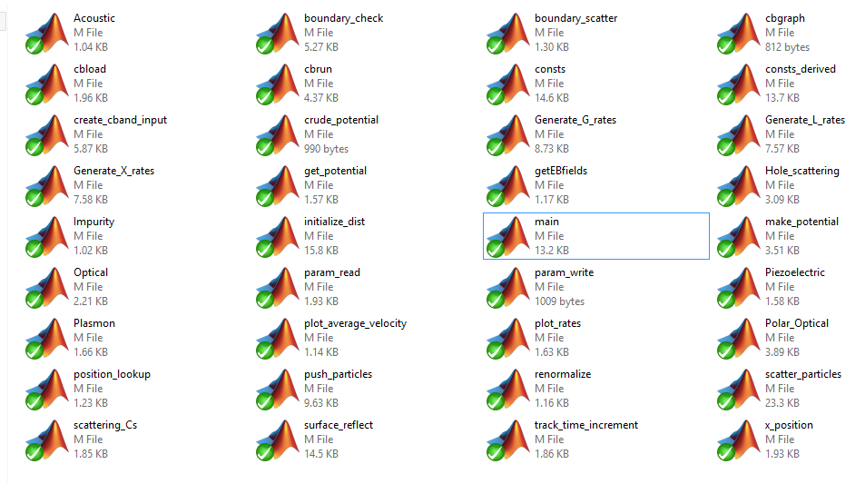
Monte-Carlo Photocathode Code
>10k lines of vectorized code
Few days on a normal PC
Few hours on a cluster
Lots of bench-marking!!!
Matlab based – also Python version now available
Developed in collaboration with Tech-X
J. App. Phys. 113 (10), 104904 (2013)

Slide 9
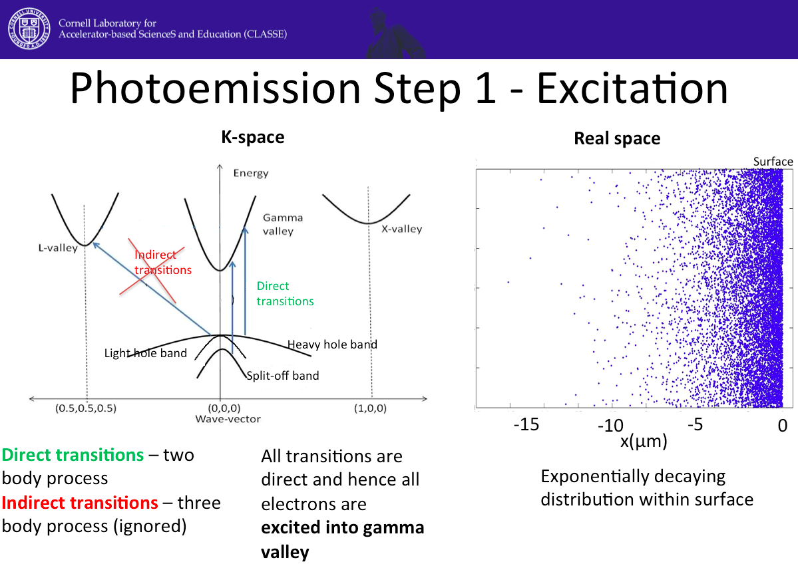
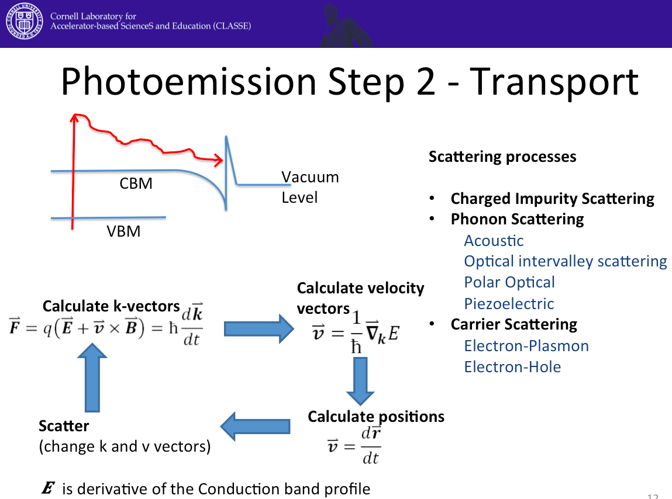
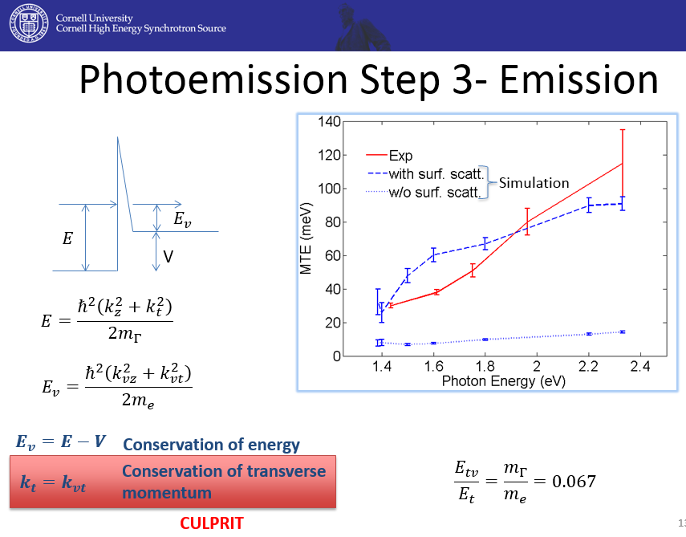
Physics Toolkit Approach
Ability to model various materials, include different scattering processes;
Excellent agreement to experiment (Cs:GaAs) in wide rage of photon energies.
Extension to layered structures;

Slide 10
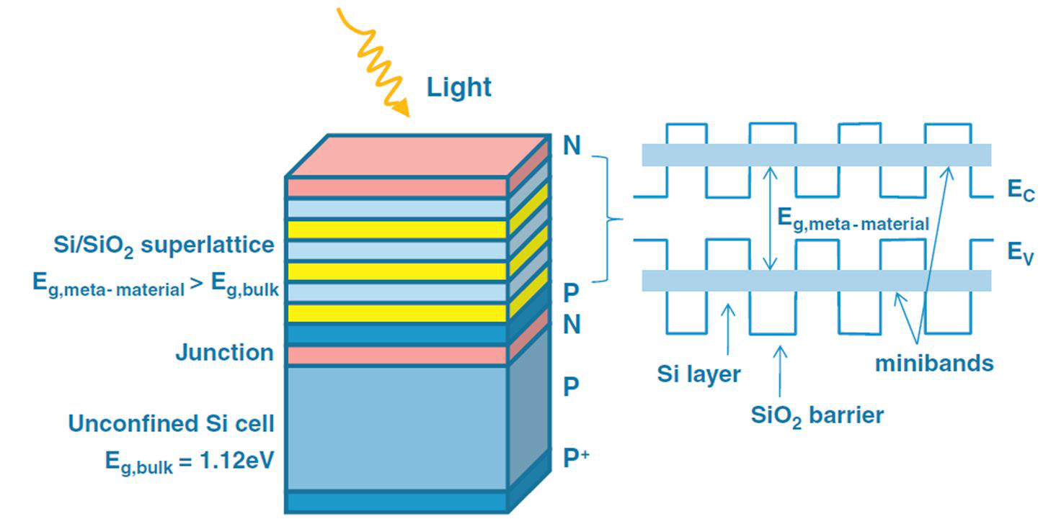
Engineering Photocathodes
Light
Easy to grow
using MBE
e⁻
Can we tune structure to improve photoemission?
Surface Layers have different doping and different material (GaAs/AlGaAs…)
Change in material causes change in band-gap
Band profiles can be calculated
using a Schrodinger-Poisson
solver
We can tune –
light absorption
X-valley min
electric fields
Γ-valley min
scattering
valley heights
Valance Band Max
Change in doping causes bands to bend

Slide 11
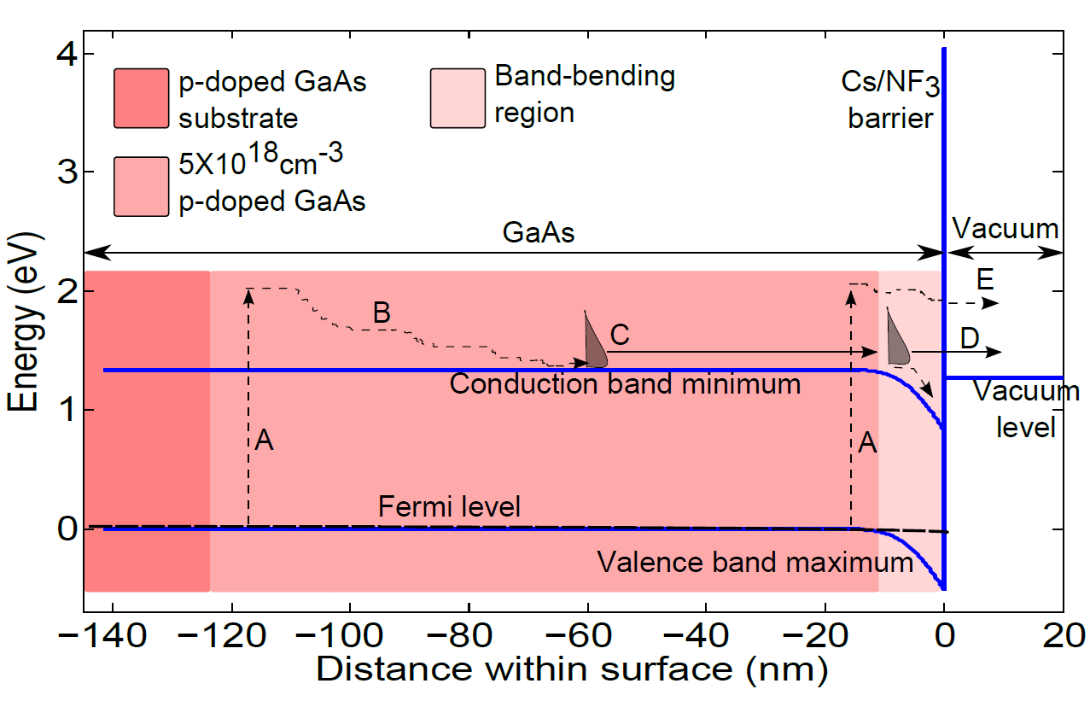
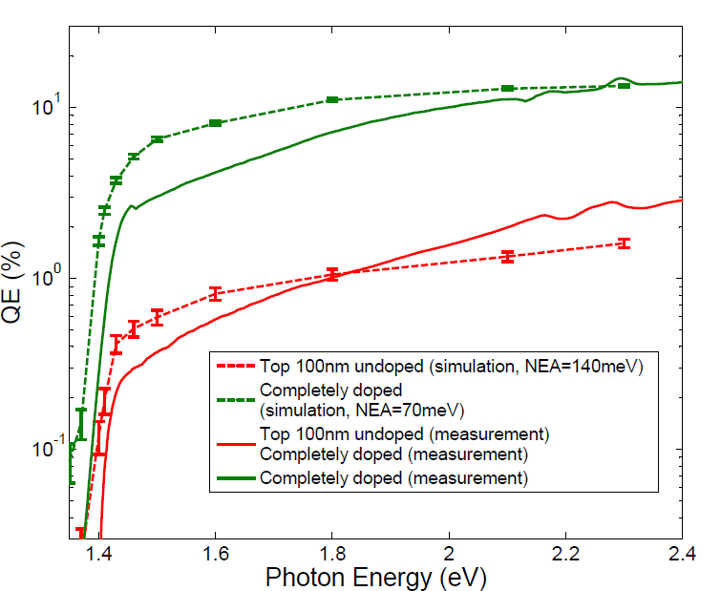
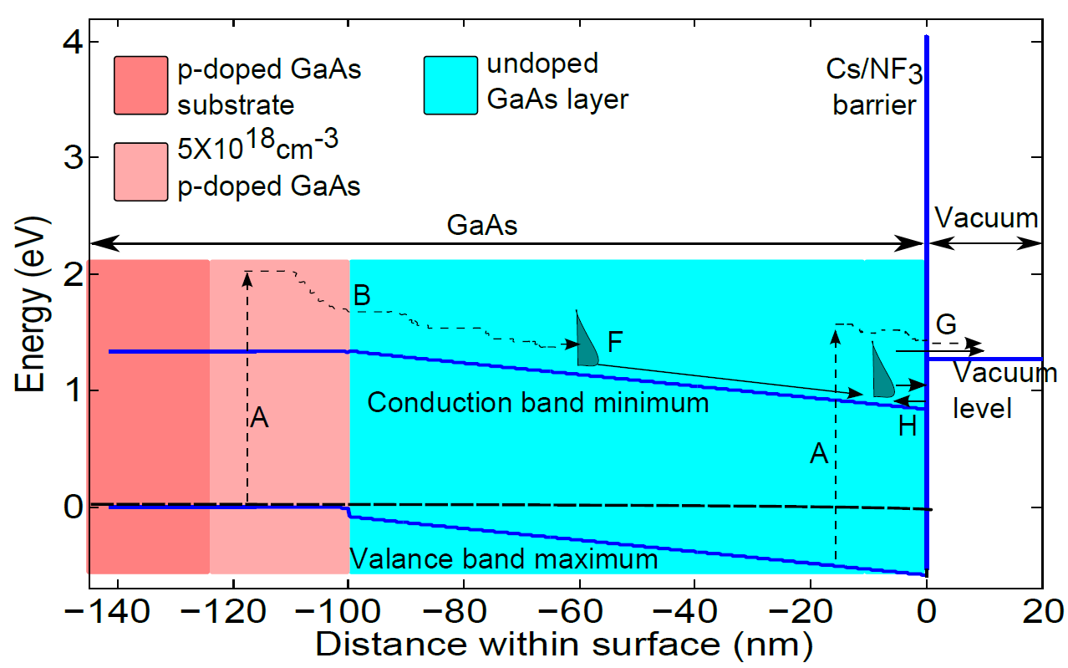
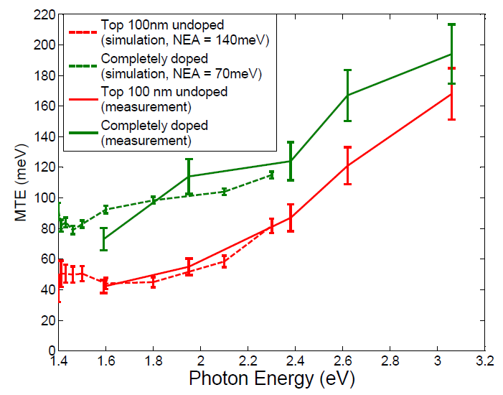
Layered Photocathodes
PRL 112 (9), 097601 (2014)
p-GaAs
QE
p-GaAs
Simulation
Experiment
Layered structure
MTE
Layered structure
p-GaAs
Layered structure
Simulation
Experiment

Slide 12
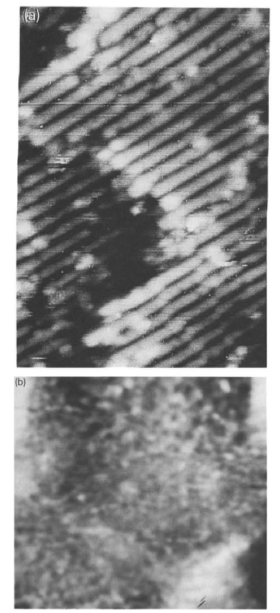
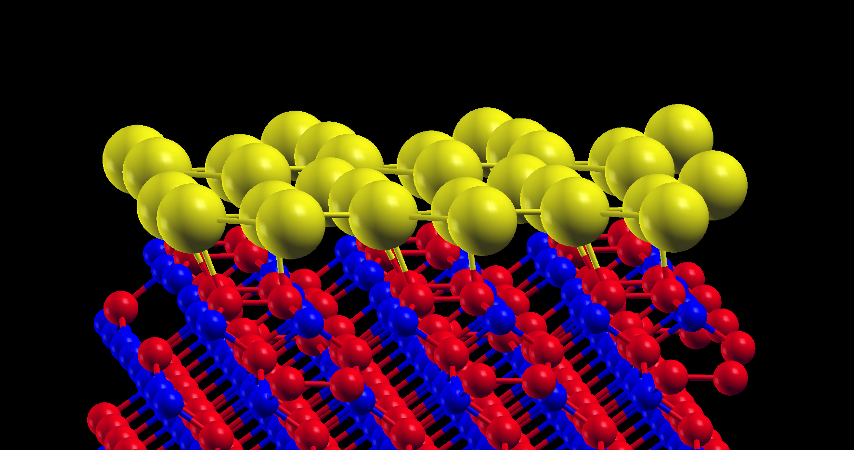
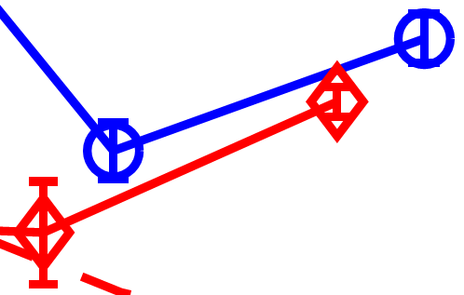
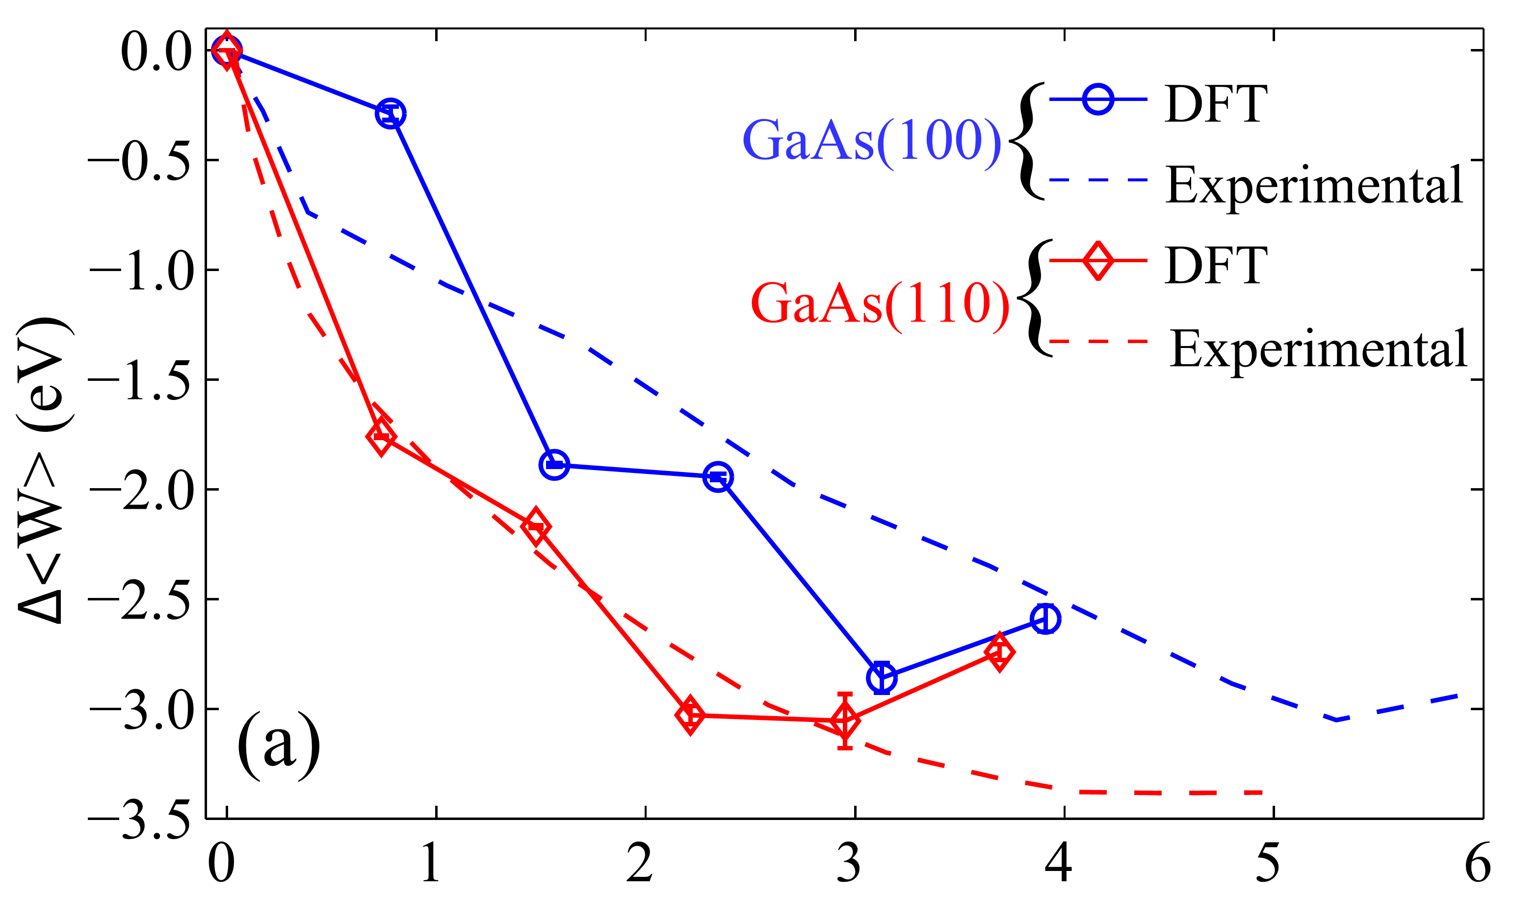
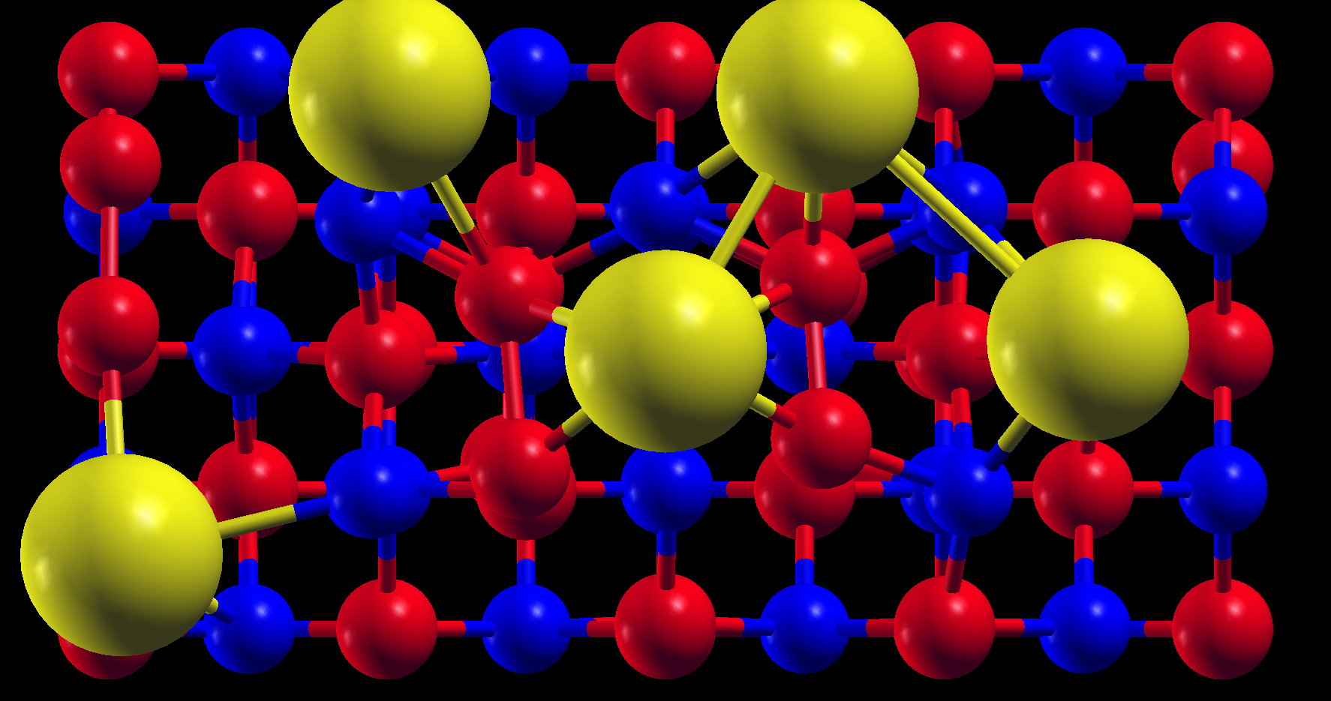
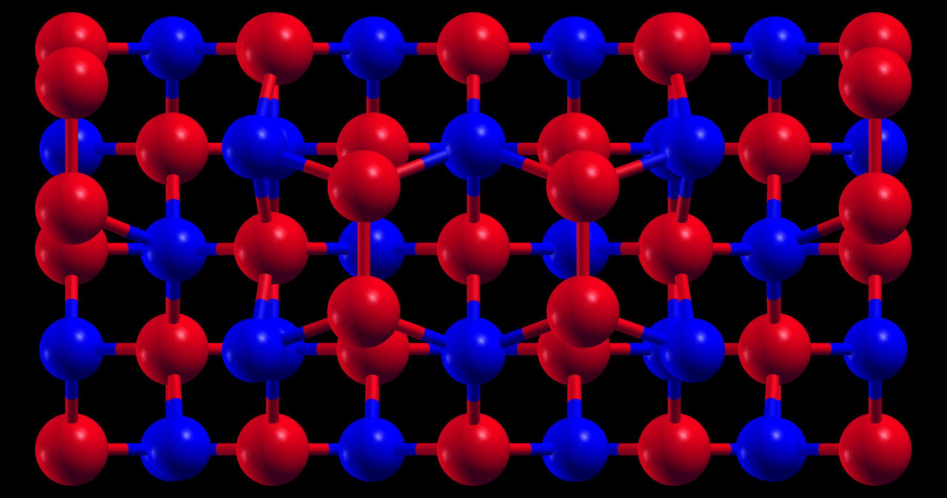
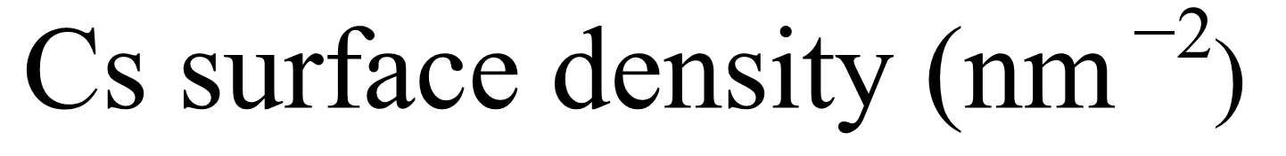






(2) Surface Effect on Photoemission
What Does the Surface Look Like?
$$17nm×37nm$$
~1 nm Surface Roughness
GaAs(100)
Random Cs
adsorption
$$\sim 120 meV$$
Raised Ga Dimer Reconstruction
$$\sim 100 meV$$
$$\sim 150 meV$$
$$\sim 250 meV$$
~100 meV Workfunction Varia-tion: Cause for a Larger MTE?
$$150nm×150nm$$
Ga
As
Top
Views
Cs
Amorphous Cs
adsorption
J. Kim, M.C. Gallagher and R.F. Willis, Appl. Surf. Sci., 67, 286 (1993)
PRB, 91, 035408 (2015)

Slide 13
Ultra-low emittance diagnostics
Resolving ≤ 10 meV of low energy (≪ eV) photo-electrons tricky;
Need for reliable diagnostics capable of diagnosing cathodes in-situ;
Must be connected to other surface analysis techniques to “debug” the physics, operate in UHV without interruptions

Slide 14
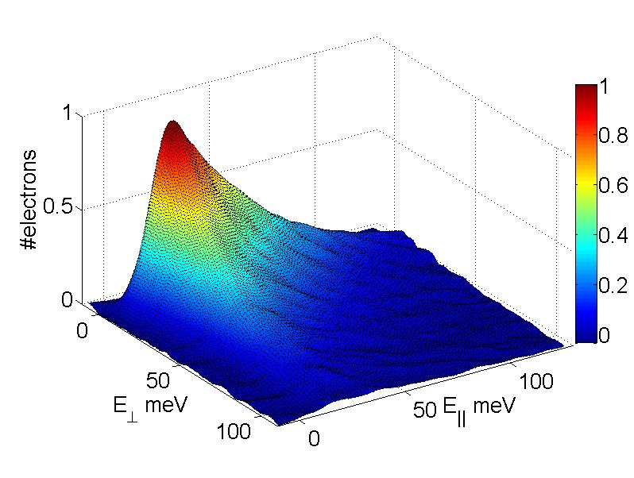
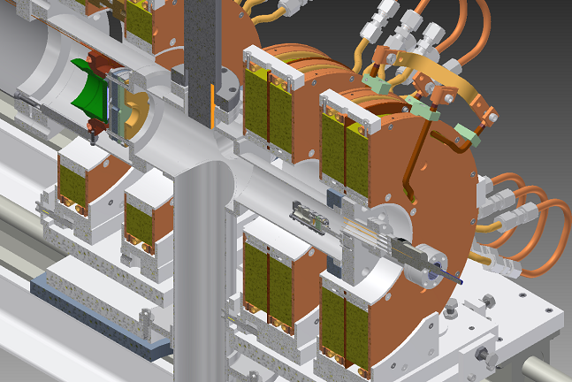
2D Energy Analyzer at Cornell
Rev. Sci. Instr. 86, 033301 (2015)
CATHODE
2-D distribution
from K2CsSb
B field
MARK1
MARK2
Improvements over its predecessor:
First Marking Electrode
Varying Magnetic Field
Second Marking Electrode
Beam Current Detector
3x Resolution (5 meV)
50x Signal to noise ratio
Compact size

Slide 15
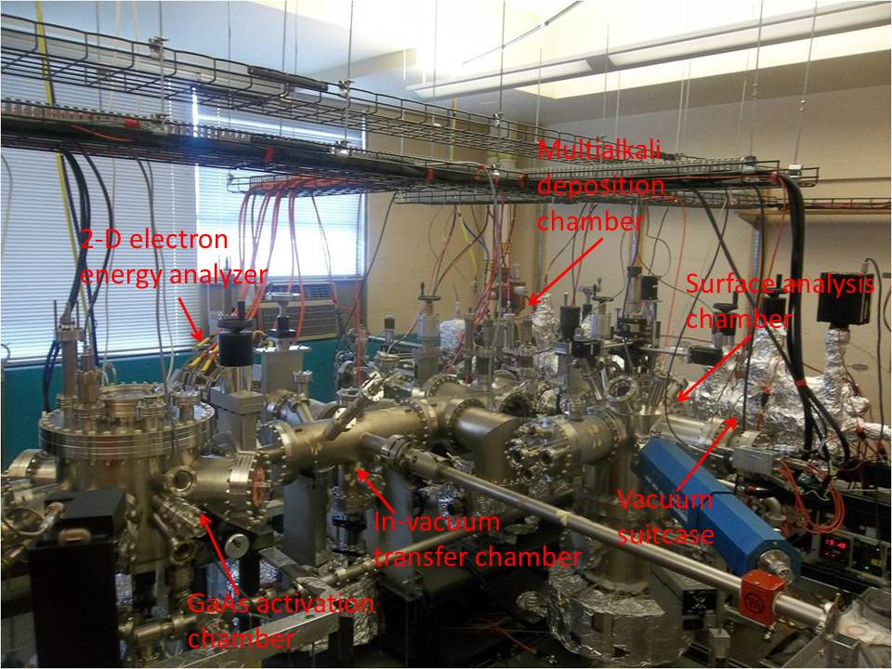
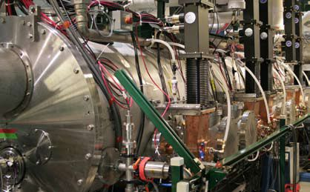
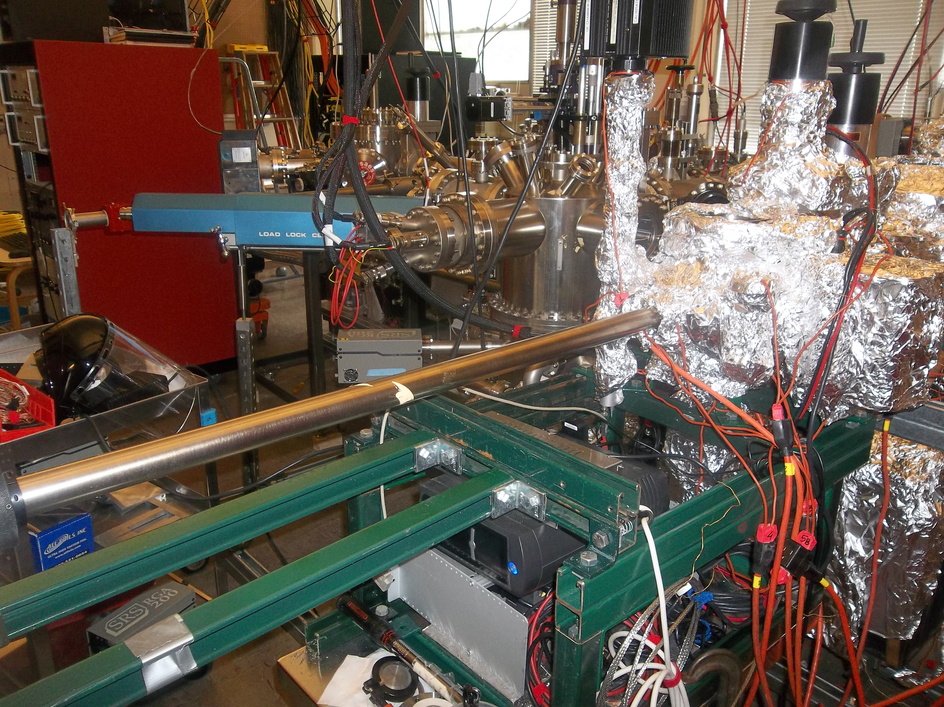
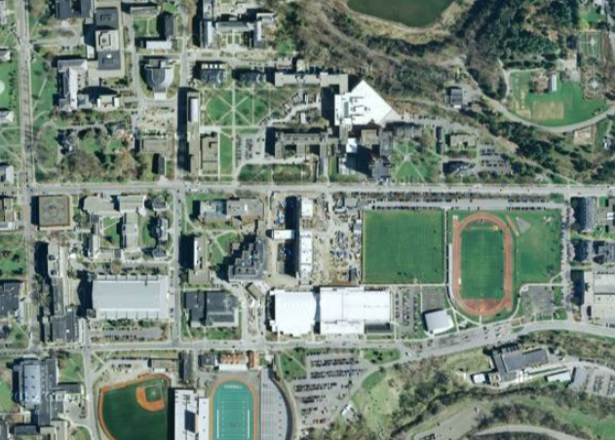
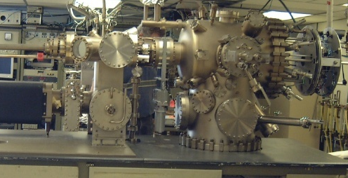
Essential Cathode Capabilities
Photocathode Growth, Diagnostics, Beam Testing at Cornell
over in Newman Lab
over in Wilson Lab
Photocathode growth & analysis chamber
Vacuum Suitcase
actual injector
Newman
over in Phillips Hall
Phillips
Wilson
Cornell University campus
dedicated MBE system

Slide 16
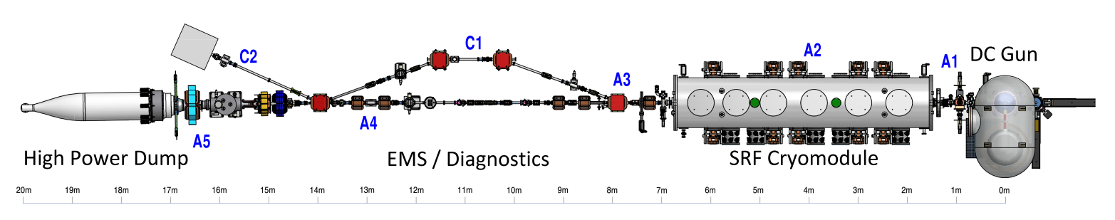
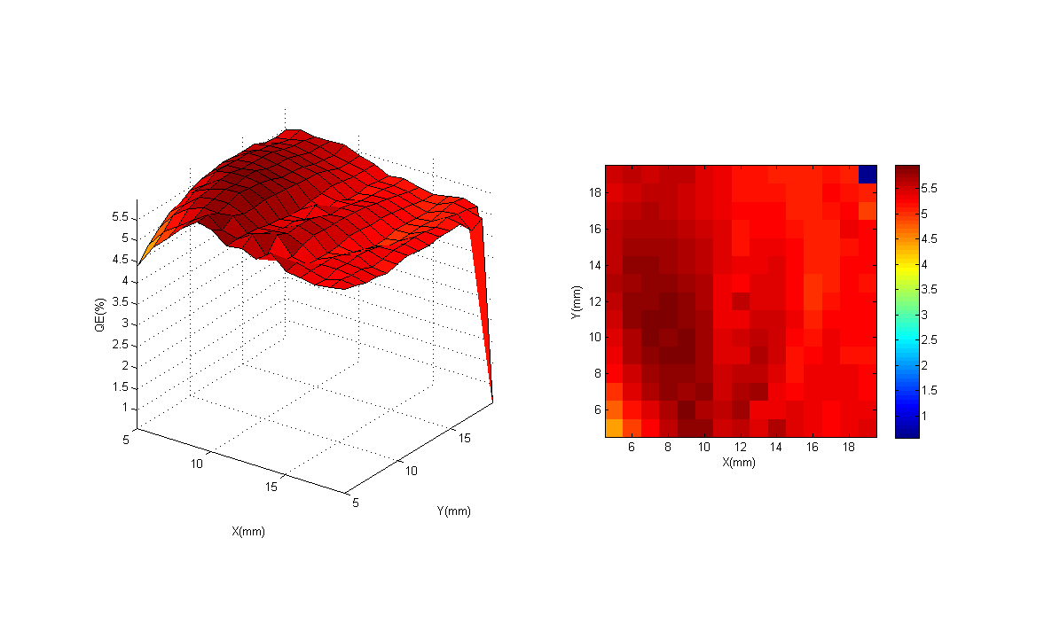
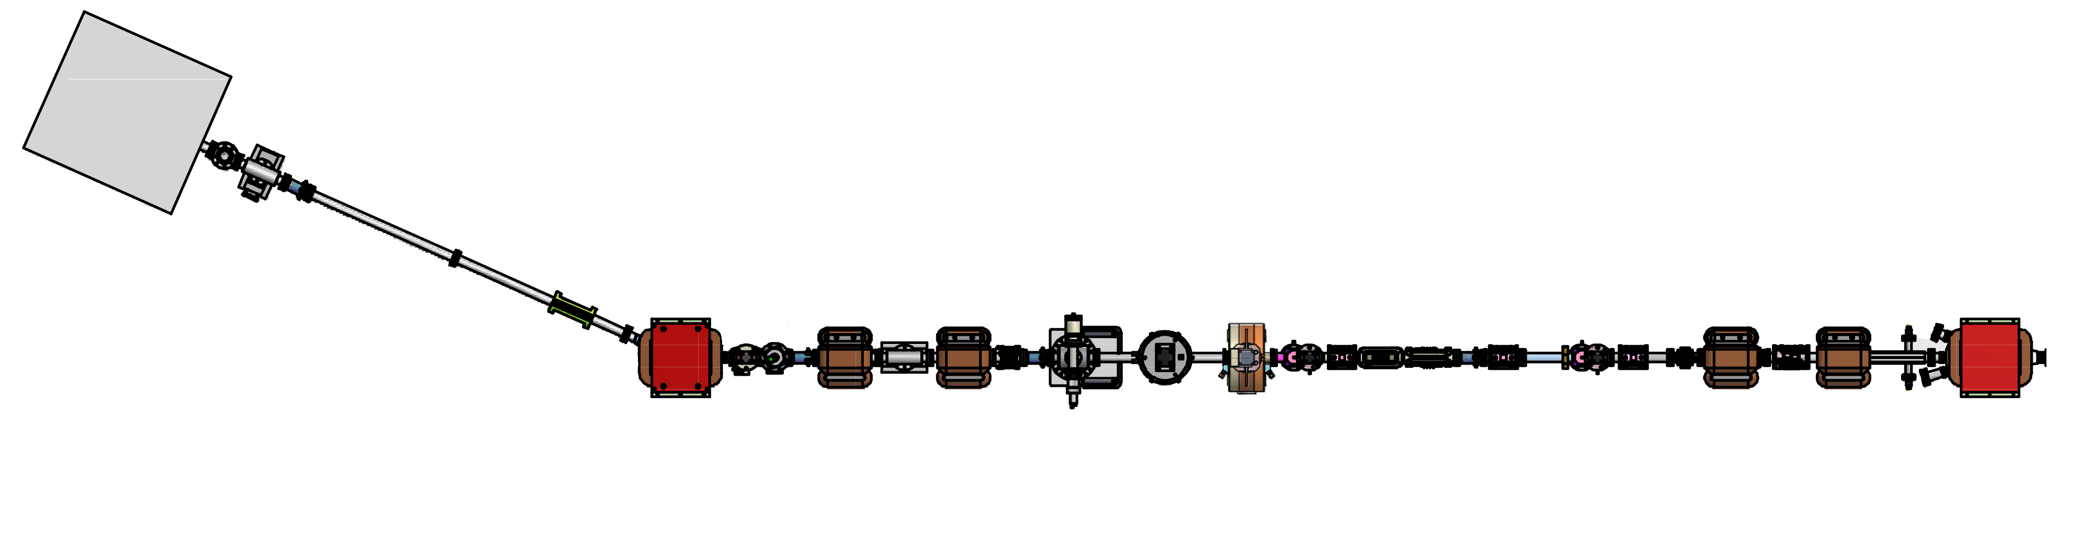
Cornell Injector Overview
6 Dimensional Phase Space Diagnostics + High Power Beam Dump + Chicane (Compton Scattering)
Short SRF Linac
5 – 15 MeV
395 kV DC Gun +
Bunching/Focusing
Emittance Measurement System
Superconducting
RF Cavities
395 kV DC Gun
NaKSb: MTE = 140 meV, QE roughly 5%
2nd Scanner
Magnet Pair
1st Scanner
Magnet Pair
Faraday Cup
Faraday Cup
+ Viewscreen
50 MHz,
520 nm
Viewscreen
Deflecting
Cavity
2nd Slit
1st Slit

Slide 17
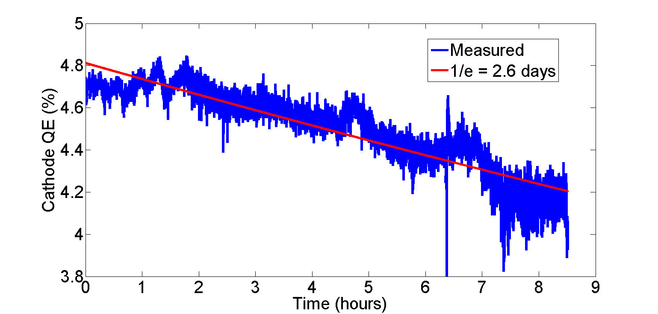
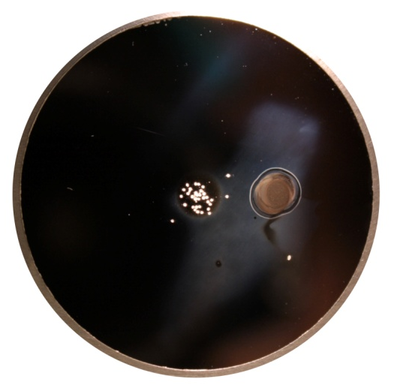
High Performance Cathodes
0.1 Amp avg current from photoinjectors with good lifetime no longer a dream
1.3 GHz laser
Lifetime good enough with the existing laser to operate for a week without interruption at ~70 mA
Learned how to minimize halo/manufacture robust cathodes
NaKSb Lifetime at 65 mA
Ion damage limited to the central area
Active area is offset from the center
Appl. Phys. Lett. 102 (2013) 034105
Appl. Phys. Lett. 103 (2013) 103504
photocathode after use

Slide 18
Laser Shaping
Transversely: clip Gaussian laser profile at a given intensity
fraction (typically 50%)
Longitudinally: Birefringent Crystals for pulse stacking:

Slide 19
Effects of the Laser Shape
Ideal Shape
Measured Shape
Emittance at 10 MeV

Slide 20
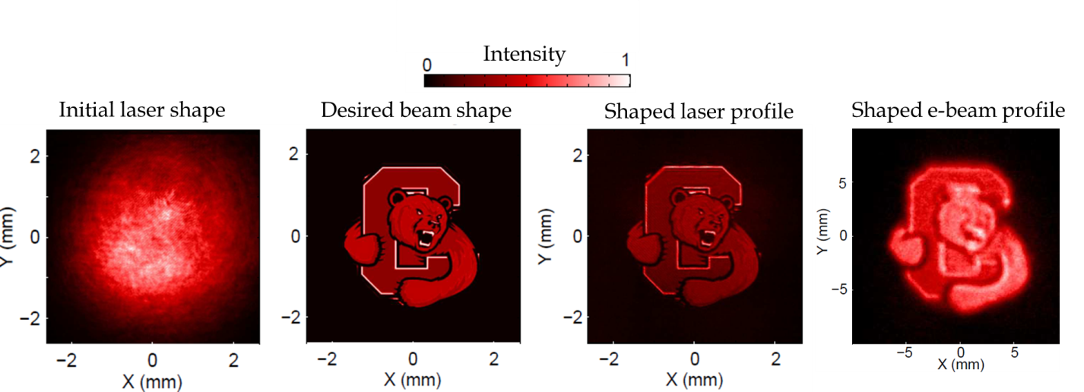
Now able to compensate for QE changes!
A new shaping method using liquid crystal spatial light modulator (SLM)
Tested with the actual e- beam
Increase emittance performance
Adaptively fix spatial QE irregularities; obtain more optimal shape
Phys. Rev. ST Accel. Beams 18, 023401 (2015)
Appl. Phys. Lett. 105 (2014) 171109

Slide 21
LCLS-II Injector Tests at Cornell
CU Injector as possible injector for high rep. rate FEL (LCLS-II)
Funded by SLAC to perform beam tests
10 MeV operation with low current (<1 mA)
Bunch charge | Peak current | Emittance (95%)
20 pC | 5 A | 0.25 μm
100 pC | 10 A | 0.4 μm
300 pC | 30 A | 0.6 μm

Slide 22
LCLS-II Specs Met…
First injector to demonstrate LCLS-II beam requirements
Appl. Phys. Lett. 106 (2015) 094101
@10 MeV kinetic energy
Q (pC) | I_{peak} Target (A) | I_{peak} (A) | ε_{n} Target (95%, μm) | ε_{n} (95%, μm) | ε_{n,th} /ε_{n}
20 | 5 | 5 | 0.25 | H: 0.18, V: 0.19 | >60%
100 | 10 | 11.5 | 0.40 | H: 0.32, V: 0.30 | >80%
300 | 30 | 32 | 0.60 | H: 0.62, V: 0.60 | >70%

Slide 23
Nanocoulomb Operation for EIC
CU Injector as a demonstration of Electron-Ion Collider technology (funded by DOE NP)
Operate at higher bunch charges (up to 2 nC)
More relaxed emittance requirements
More relaxed bunch length
High current (up to 50 mA @ 50 MHz repetition rate, 1 nC)
  Requires running off center on cathode

Slide 24
1 & 2nC Results
1 nC: 1.6 μm, 2 nC: 4.4 μm (95%)
1 nC: 1.6 μm, 2 nC: 4.0 μm (95%)
submitted to PRSTAB (2015)

Slide 25
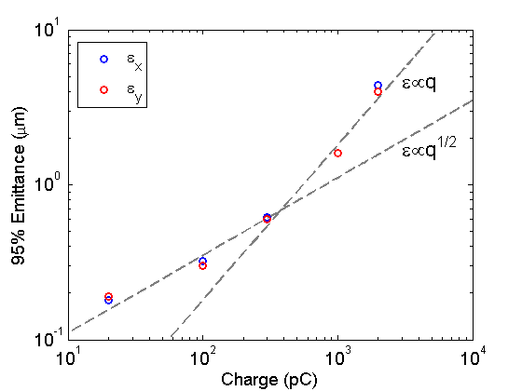
Emittance growth vs. charge
The trend starts out as q^{1/2}, and becomes more linear around 300 pC…
Q (pC) | Peak current (A) | Emittance (95%, μm)
20 | 5 | H: 0.18 V: 0.19
100 | 11.5 | H: 0.32 V: 0.30
300 | 32 | H: 0.62 V: 0.60
1000 | 50 | H: 1.6 V: 1.6
2000 | 56 | H: 4.4 V: 4.0

Slide 26
Next Steps
Emittance of well-designed photoinjectors is dominated by photocathodes (e.g. ~90% for Cornell)
  Plenty of room for further increase of brightness;
  Key direction to pursue: MTE = 1-2 meV photocathodes (limit due to Disorder-Induced-Heating);
Exciting directions:
  Cryogenic cathodes (MTE limited by the lattice temperature)
  Surface engineering (avoid Cs layer or its scattering)
New approaches for improving cathode longevity
  Thin protective layers

Slide 27
Big Impact
x100 Brightness Improvement in View
Huge Impact: e.g. this would enable
  Compact xFELs (100’s of MeV)
  Extend fs electron diffraction to proteins

Slide 28
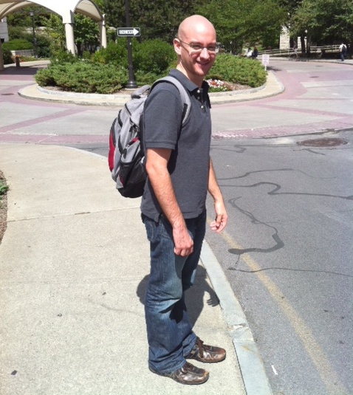

Training for future
PhD students
>10 undergrads who participated in the research over 5 years

Slide 29
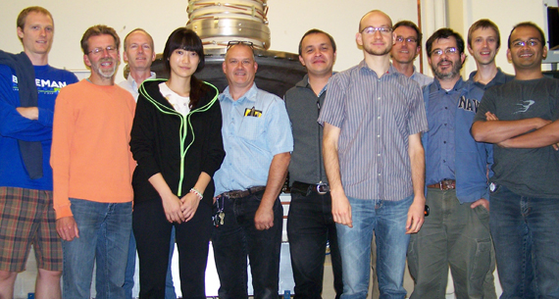
Cornell High Brightness Sources Group
Cornell High-Brightness Beam Group:

Slide 30
Backup Slides

Slide 31
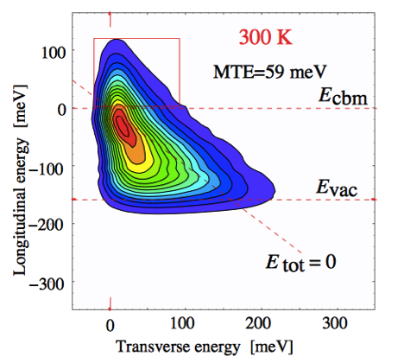
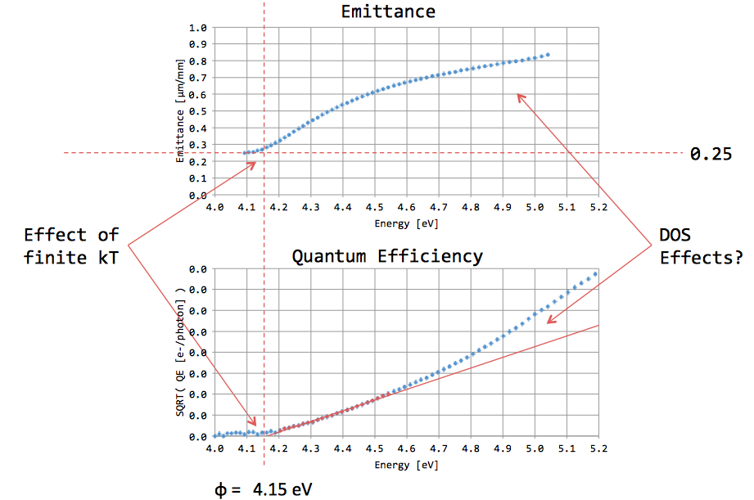
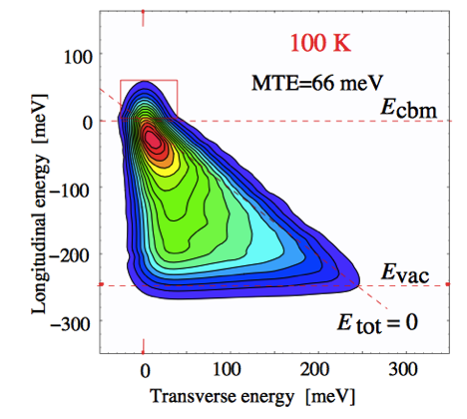
Ultracold (cryo) photocathodes
Find materials with the room temperature MTE and cool them!
Trading QE for lower MTE (still worth doing so for many apps);
Try materials with higher density of states;
Get MTE’s similar to ionized ultracold (MOT) atoms.
GaAs
oxidized antimony @ RT
MTE = 25 meV
U. Weigel, PhD thesis (2003)
T. Vecchione, P3 Cornell workshop (2012)

Slide 32
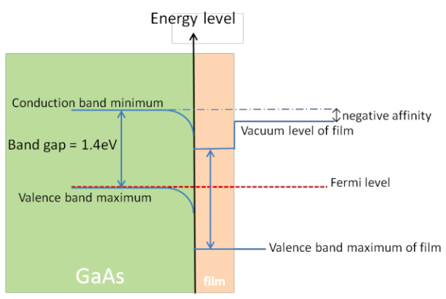
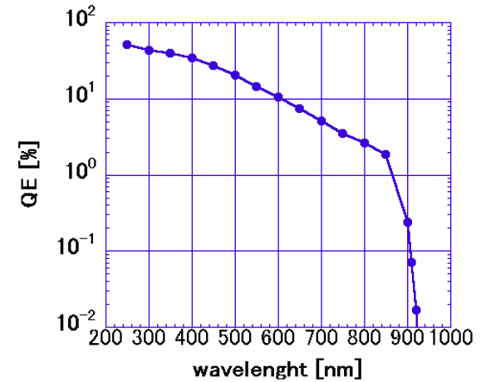
Protective layers?
Sensitive to 900 nm!
GaAs
Cs₂Te
thin layer
What happens to lifetime?
What happens to the polarization?
K. Uchida et al., IPAC’14 (2014) 664
Notes:
Masao Kuriki

