Slide 1
High brightness electron source using cryo-DC HV photogun
Ivan Bazarov (Cornell University)

Slide 2
Acknowledgements
Hyeri Lee (PhD student)
Xianghong Liu
Luca Cultrera
Val Kastroun
Bruce Dunham
Colwyn Gulliford
Adam Bartnik
Funding by the NSF Grant No. PHY-1416318
And the DOE DE-SC0014338 and DE-SC0011643

Slide 3
Outline
Drivers for high brightness
Experimental evidence in favor of cooling cathodes
Cryo-cooled HV DC gun concept
Simulated performance
Gun construction & first beam

Slide 4
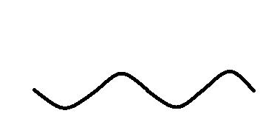
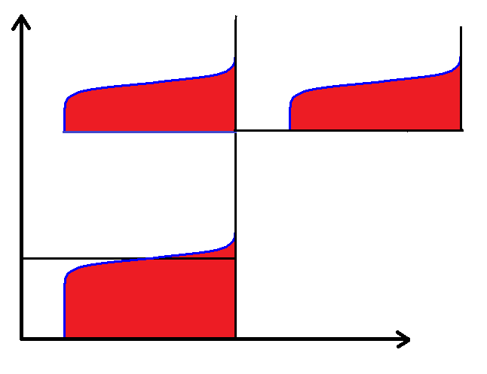
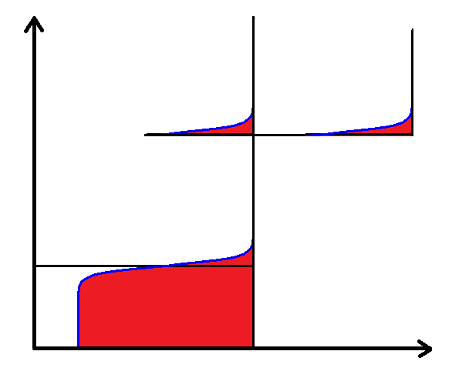
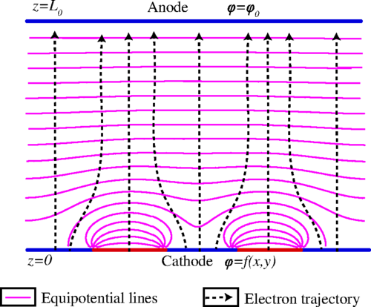




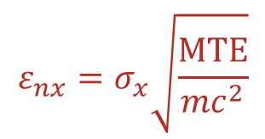
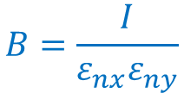
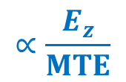
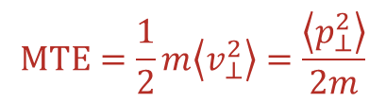
Brightness, Emittance and Disordered Cathodes
E_{z} (sets maximum electron density)
$$MTE=\frac{1}{2}m\left\langle v_{⊥}^{2}\right\rangle =\frac{\left\langle p_{⊥}^{2}\right\rangle }{2m}$$
Photocathode
electrons
$$B=\frac{I}{ε_{nx}ε_{ny}}$$
$$∝\frac{E_{z}}{MTE}$$
electron beam
$$ε_{nx}=σ_{x}\sqrt{\frac{MTE}{mc^{2}}}$$
Laser
All photoinjectors use cathodes with disordered surfaces
(e.g. alkali-antimonides, polycrystalline metals, Cs:GaAs)
$$MTE=\frac{E_{x}}{3}$$
$$=kT (E_{x}→0)$$
Vacuum Level
Energy
$$W$$
Fermi Level
$$ℏω$$
$E_{x}$→0
Temperature, surface roughness, and work function variations eventually limit MTE
$$E_{x}$$
Appl. Phys. Lett. 107, 134101 (2015)
Phys. Rev. Applied 4, 024015 (2015)
J. Appl. Phys. 121, 044904 (2017)

Slide 5
Cornell’s Center for Bright Beams
x100 brighter electron beams through better photocathodes, guns, beam dynamics, etc.

Slide 6
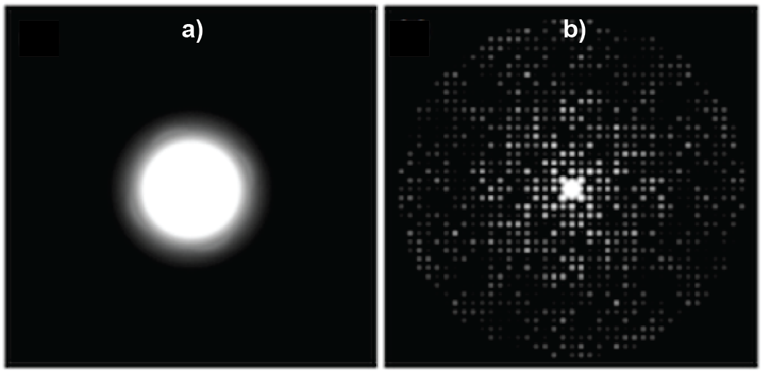
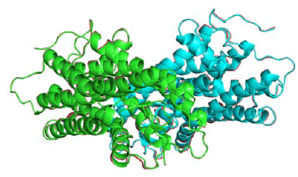
Ultrafast electron diffraction
Toward a molecular movie for biological processes with electrons…
light sensitive
protein rhodopsin
State-of-the art 100 fs electron source
With 100x more brightness
Coherence length ≥ protein unit cell (~few nm)
Time resolution ~100fs (ultrafast scale)
Number of electrons (for signal) ≥ 10⁵

Slide 7
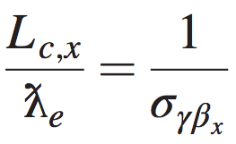
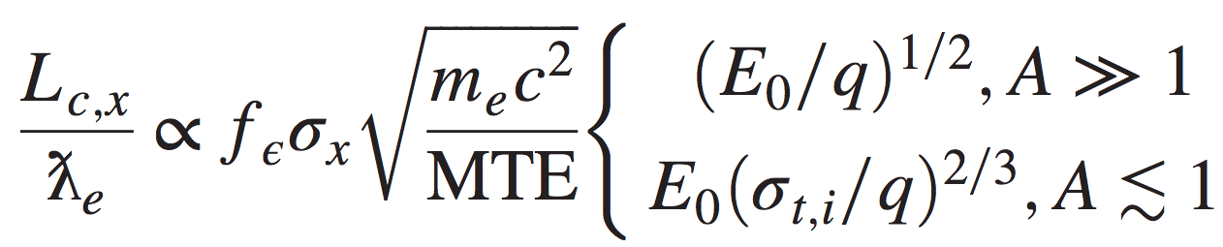
Coherence length scaling
reduced Compton wavelength
cathode field
final spot size
(“pancake”)
(“cigar”)
cathode emittance preservation ratio ∊ (0, 1]
Phys. Rev. Acc. Beams 19, 093402 (2016)

Slide 8
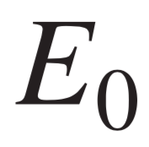
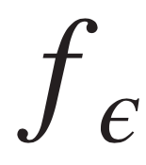
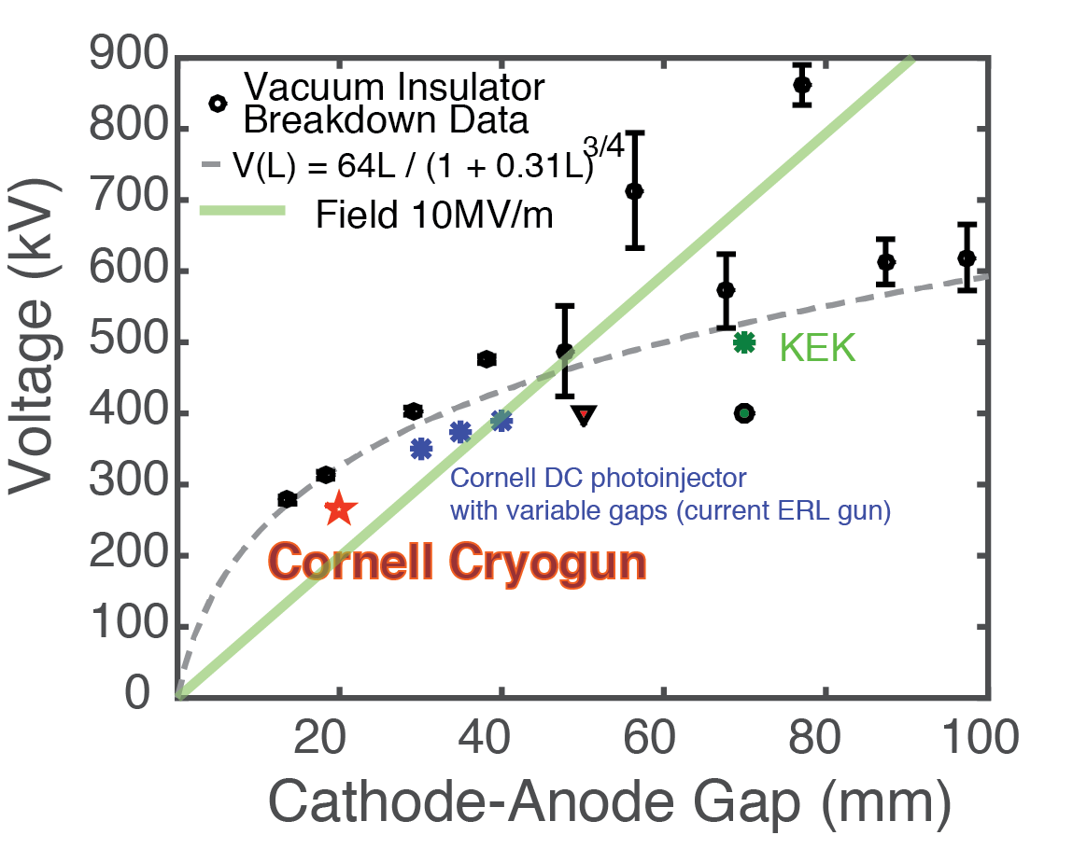

Points of impact
cathode field
emittance preservation
breakdown (DC vs RF; field vs voltage)
genetic algorithms & beamline optimization
≥10 MV/m DC field doable
initial beam temperature
cold atoms, single-crystal cathodes, cooling disordered cathodes

Slide 9
Cooling alkali antimonides to 90K

Slide 10
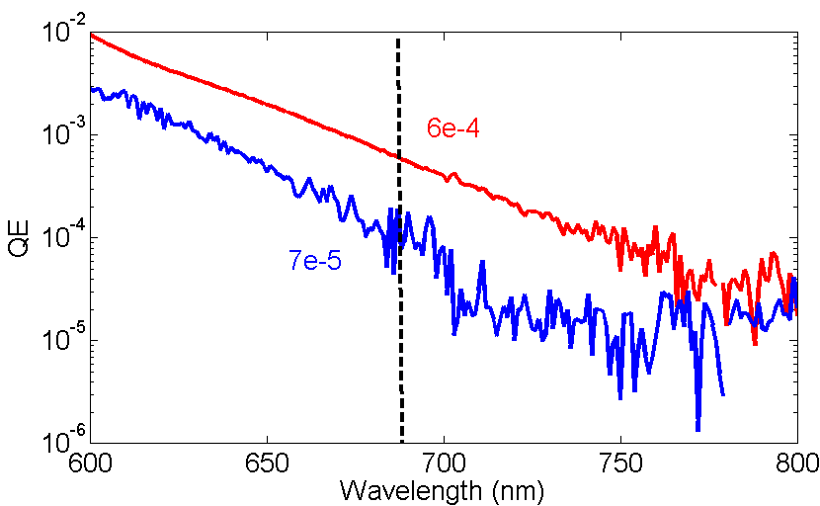
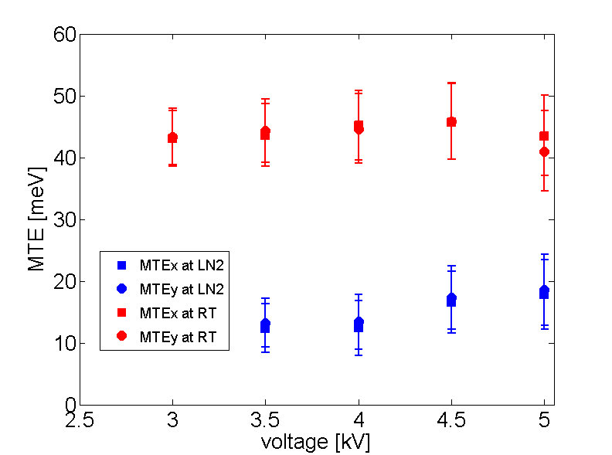
Cooling alkali antimonides to 90K
What happens if we cool the cathode to cryogenic temperature?
As T lowers from 300 K to 90 K, MTE should lower from 25 to 8 meV
~0.3 mm mrad
~25 meV at 300 K
~0.17 mm mrad
~8 meV at 90 K
actual MTE ~14 meV or 160 K equiv. temp.

Slide 11
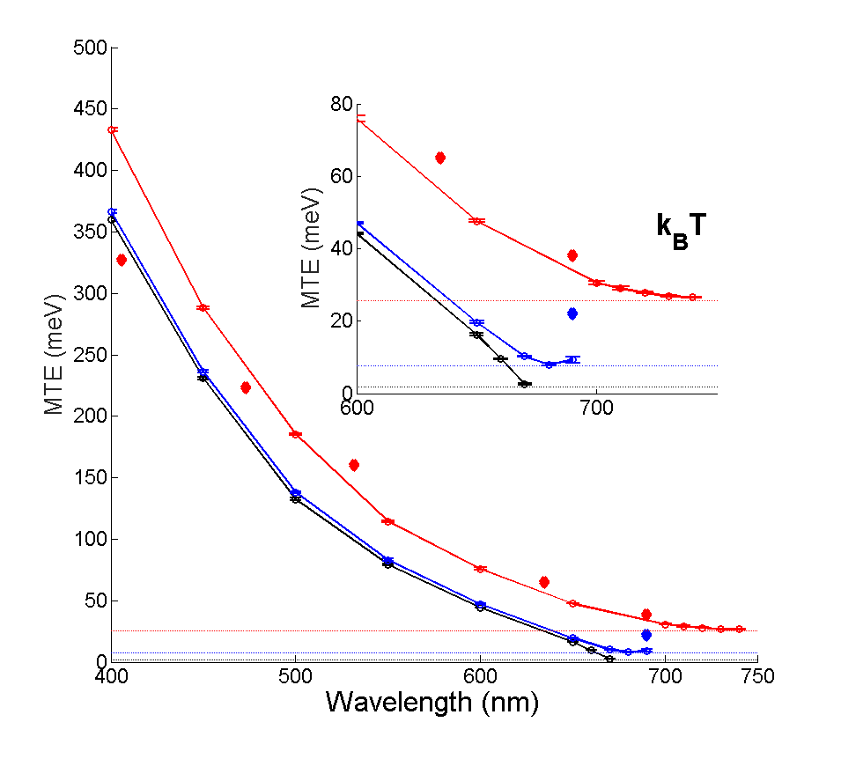
Cooling even further?
We suspect that the cathode roughness manifests itself here
Active research ongoing that promises much smoother surface
Our Monte-Carlo modeling of the bulk scattering suggests cryo-cooling can bring MTE further down
~2 meV is predicted @ 20K
J. Appl. Phys 121 (2017) 215702

Slide 12
Transmission cathodes
Appl. Phys. Lett. 108, 124105 (2016)

Slide 13
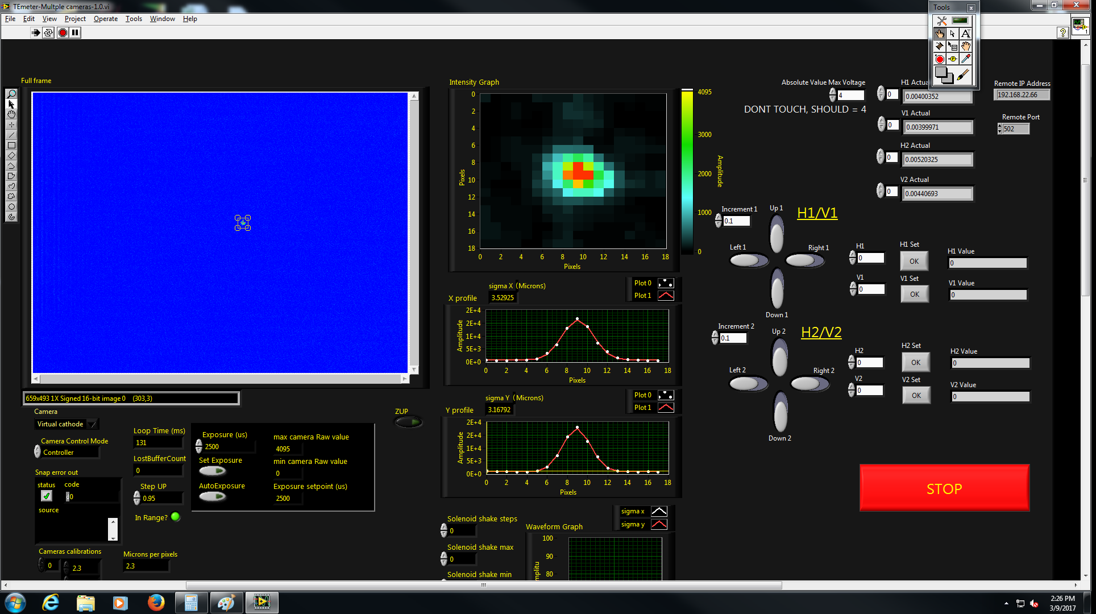
Best configuration for tight laser focusing

Slide 14
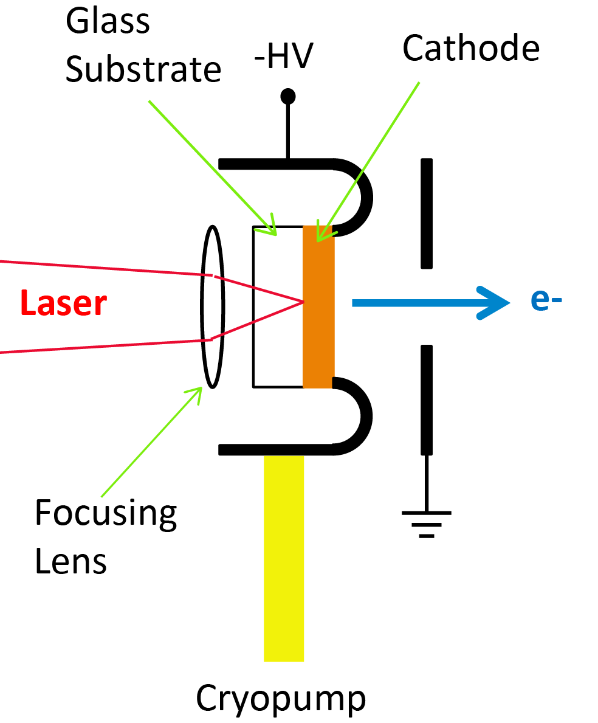
Cryo-cooled photogun concept
1) HV DC photoemission gun
- Voltage: >200kV
- Cathode E-field: >10MV/m
2) Cathode cryo-T (20K)
3) Compact design

Slide 15
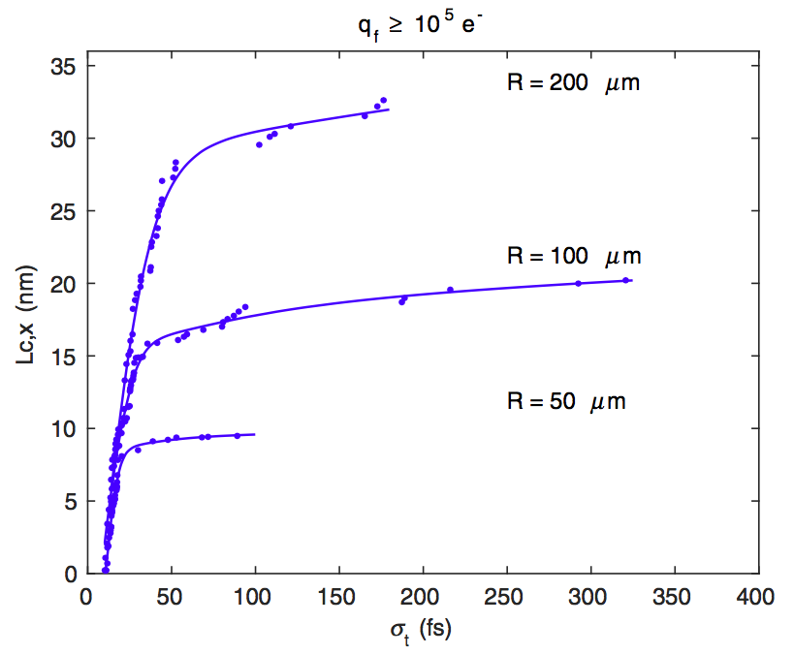
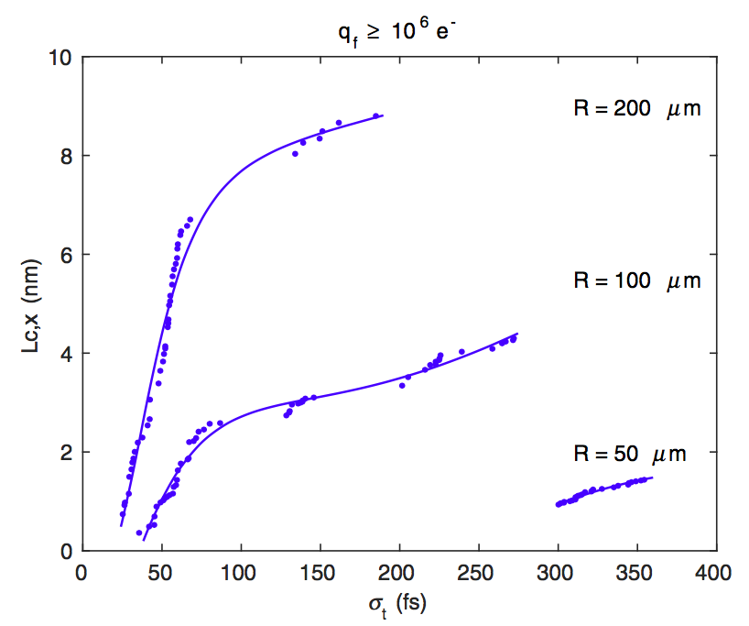
Simulated performance
Phys. Rev. Acc. Beams 19, 093402 (2016)

Slide 16
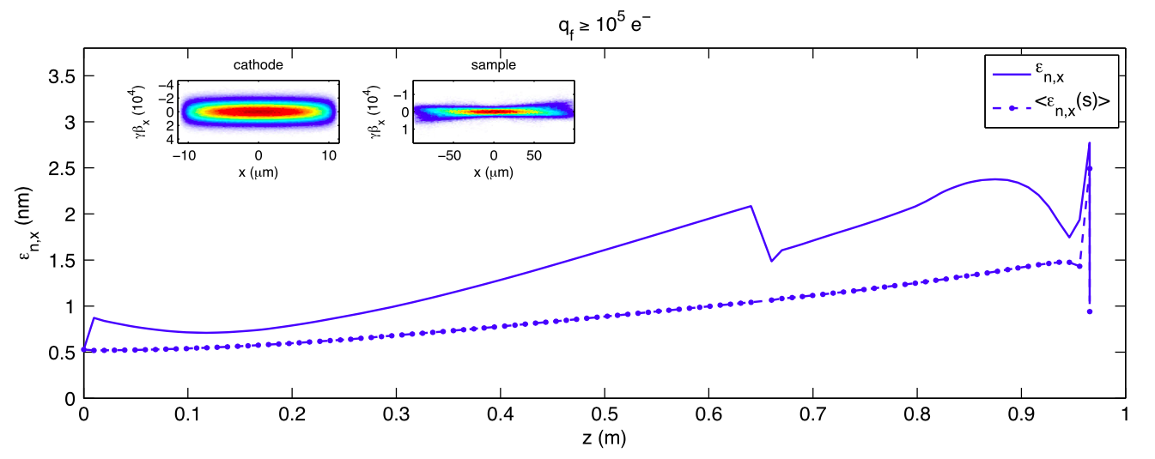
10⁵ electrons (MTE = 5 meV)
MTE accounts for ≤1/2 final emittance
Phys. Rev. Acc. Beams 19, 093402 (2016)

Slide 17
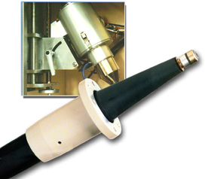
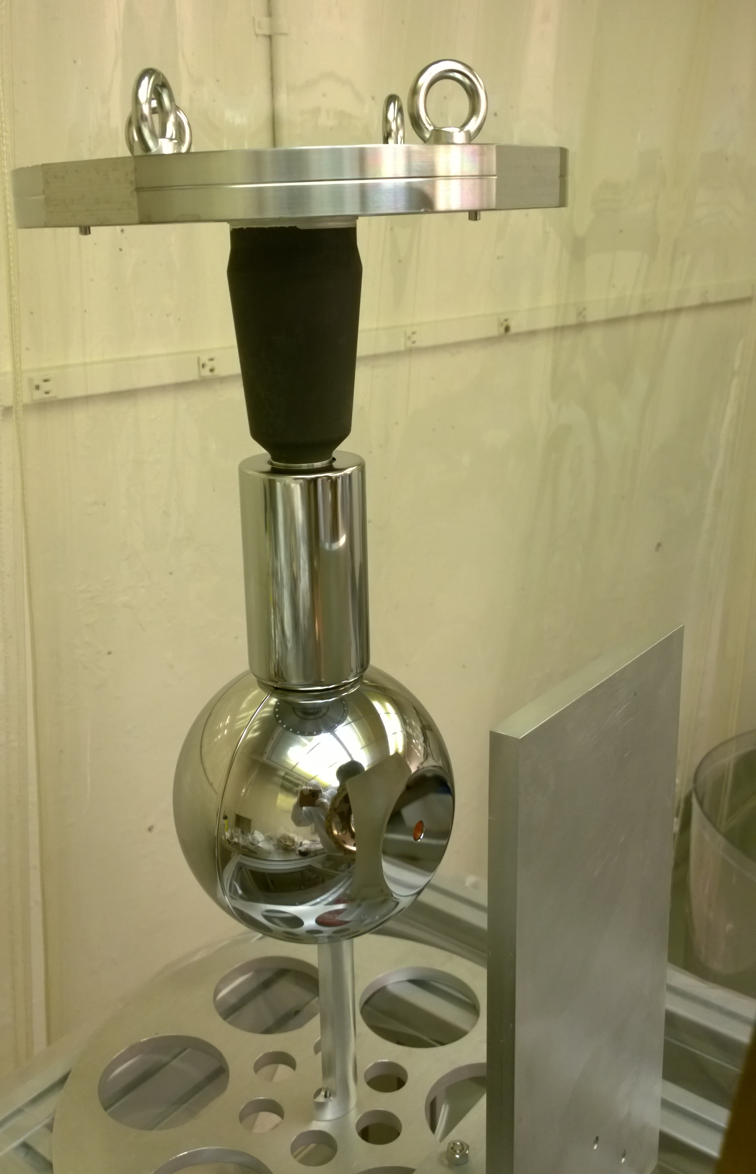
Gun construction

Slide 18
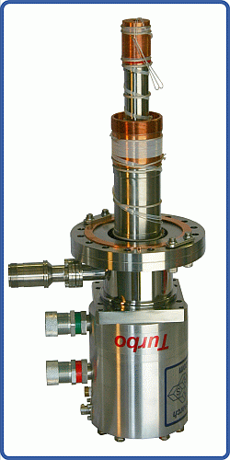
Cryo-tests
Cryopump
(~6W at 15K)
At the cathode
43±1K

Slide 19
HV processing

Slide 20
Puck transfer
Interface jacket to the old Cornell puck

Slide 21
First beam!
Made first beam at ~200 kV (10MV/m) at both RT and cryo-T (40K)
The gun is now being relocated to its permanent home, more results soon!

