Slide 1
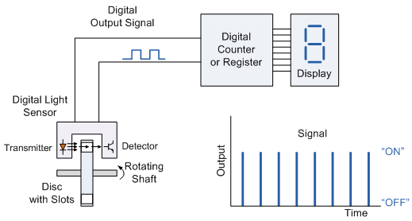
Transducers
PHYS3360/AEP3630
Lecture 33

Slide 2
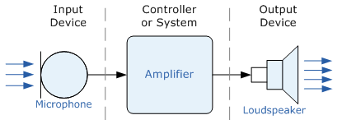
Terminology
Transducers convert one form of energy into another
Sensors/Actuators are input/output transducers
Sensors can be passive (e.g. change in resistance) or active (output is a voltage or current level)
Sensors can be analog (e.g. thermocouples) or digital (e.g. digital tachometer)
Sensor
Actuator
Notes:
Energy form conversion: electrical signals, movement, radiant energy, thermal, or magnetic energy, etc.
Sensors/Actuators – both are transducer types
Analog-sensor-produced signals can be digitized

Slide 3
Transducer types
Quantity being Measured | Input Device (Sensor) | Output Device (Actuator)
Light Level | Light Dependant Resistor (LDR), Photodiode, Phototransistor, Solar Cell | Lights & Lamps, LED's & Displays, Fiber Optics
Temperature | Thermocouple, Thermistor, Thermostat, Resistive temperature detectors (RTD) | Heater, Fan, Peltier Elements
Force/Pressure | Strain Gauge, Pressure Switch, Load Cells | Lifts & Jacks, Electromagnetic, Vibration
Position | Potentiometer, Encoders, Reflective/Slotted Opto-switch, LVDT | Motor, Solenoid, Panel Meters
Speed | Tacho-generator, Reflective/Slotted Opto-coupler, Doppler Effect Sensors | AC and DC Motors, Stepper Motor, Brake
Sound | Carbon Microphone, Piezo-electric Crystal | Bell, Buzzer, Loudspeaker

Slide 4
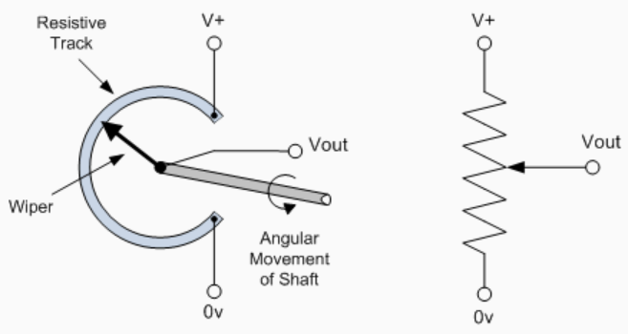
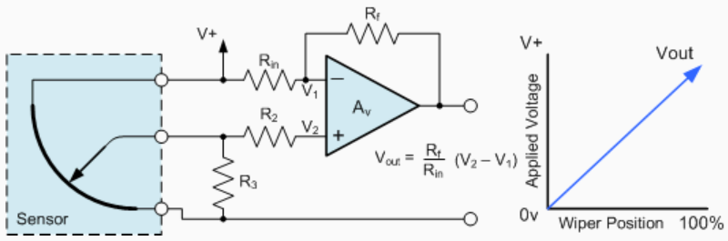
Positional Sensors: potentiometer
Can be Linear or Rotational
Processing circuit
Notes:
Can be Linear or Rotational

Slide 5
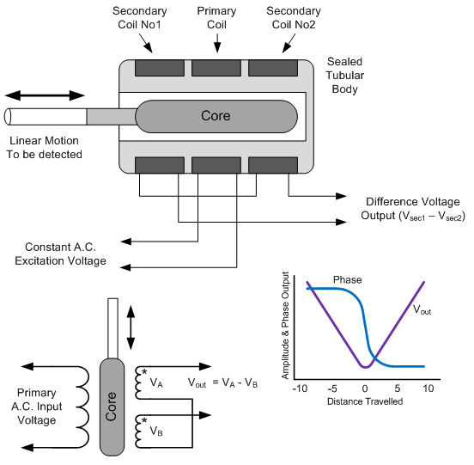
Positional Sensors: LVDT
Linear Variable Differential Transformer

Slide 6
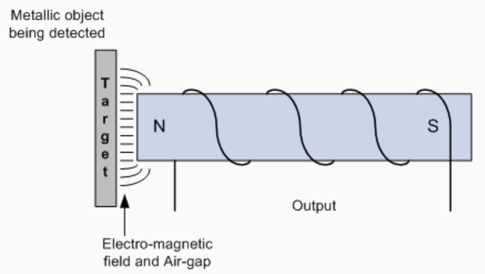
Positional Sensors: Inductive Proximity Switch
Detects the presence of metallic objects (non-contact) via changing inductance
Sensor has 4 main parts: field producing Oscillator via a Coil; Detection Circuit which detects change in the field; and Output Circuit generating a signal (NO or NC)
Used in traffic lights (inductive loop buried under the road). Sense objects in dirty environment.
Does not work for non-metallic objects. Omni-directional.
Notes:
Used in traffic lights (inductive loop buried under the road). Sense objects in dirty environment.
Does not work for non-metallic objects. Omni-directional.

Slide 7
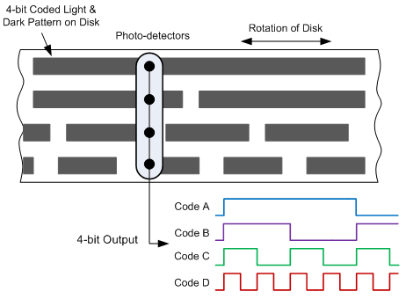
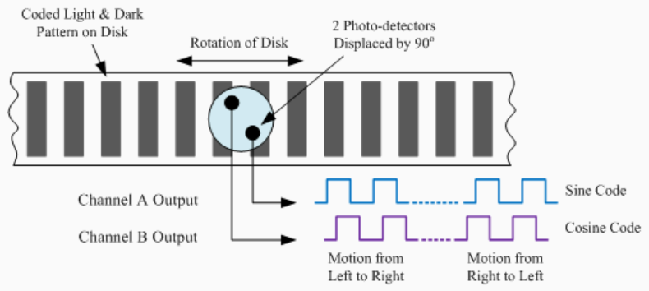
Positional Sensors: Rotary Encoders
Incremental and absolute types
Incremental encoder needs a counter, loses absolute position between power glitches, must be re-homed
Absolute encoders common in CD/DVD drives

Slide 8
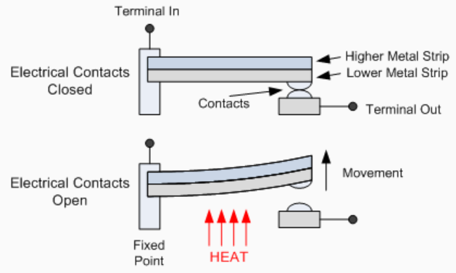
Temperature Sensors
Bimetallic switch (electro-mechanical) – used in thermostats. Can be “creep” or “snap” action.
Thermistors (thermally sensitive resistors); Platinum Resistance Thermometer (PRT), very high accuracy.
Creep-action: coil or spiral that unwinds or coils with changing temperature
Notes:
Creep-action: coil or spiral that unwinds or coils with changing temperature

Slide 9
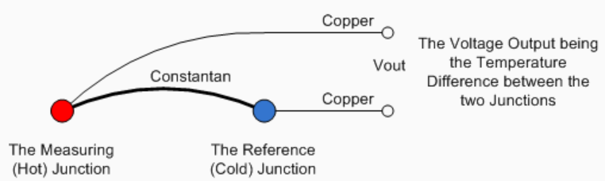
Thermocouples
Two dissimilar metals induce voltage difference (few mV per 10K) – electro-thermal or Seebeck effect
Use op-amp to process/amplify the voltage
Absolute accuracy of 1K is difficult

Slide 10
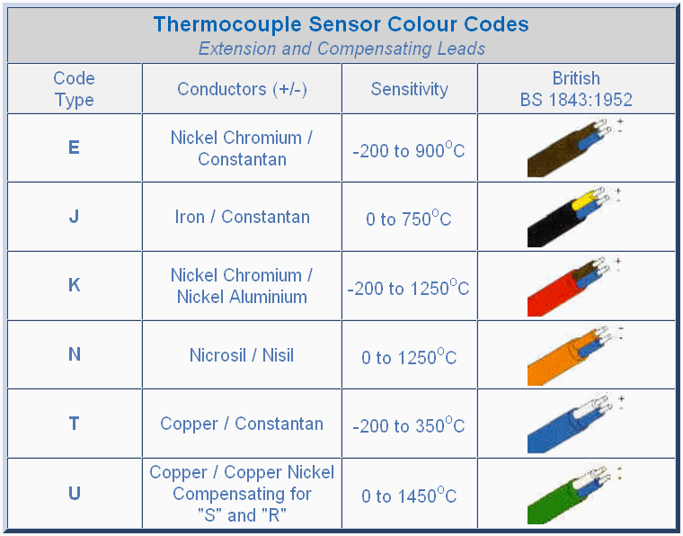

Slide 11
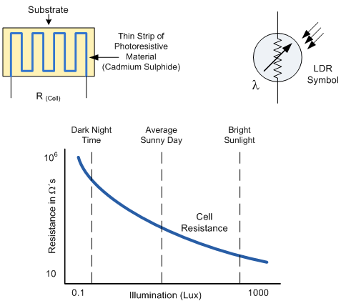
Light sensors: photoconductive cells
Light dependent resistor (LDR) cell

Slide 12
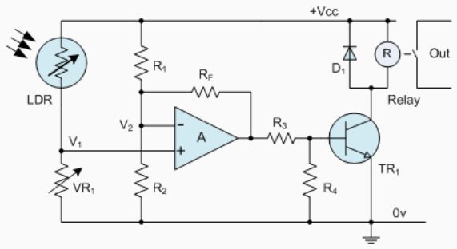
Light level sensitive switch

Slide 13
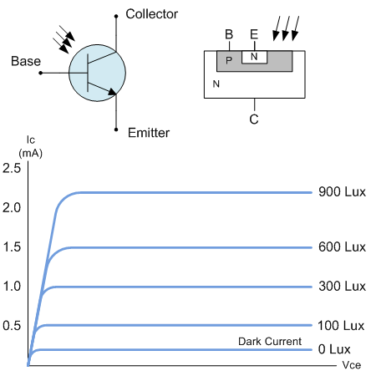
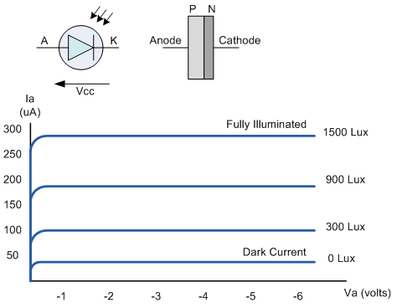
Photojunction devices
phototransistor
photodiode

Slide 14
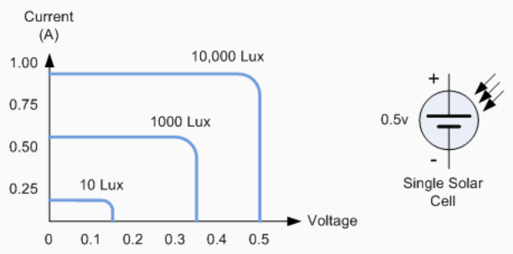
Photovoltaic Solar Cells
Can convert about 20% of light power into electricity
Voltage is low (diode drop, ~0.6V)
Solar power is 1.4kW/m^2
Notes:
Solar power is 1.4kW/m^2

Slide 15
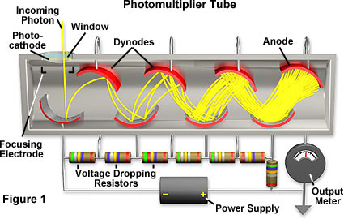
Photomultiplier tubes (PMT)
Most sensitive of light sensors (can detect individual photons)
Acts as a current source
electrons

Slide 16
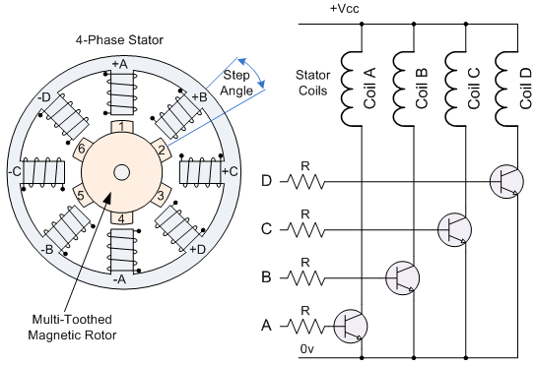
Motion sensors/transducers
Switches, solenoids, relays, motors, etc.
Motors
  DC
    Brushed/brushless
    Servo
    Stepper motors
  AC
Stepper motor
Brushed motor – permanent magnets on armature, rotor acts as electromagnet
Brushless motor – permanent magnet on the rotor, electromagnets on armature are switched
Notes:
Brushed motor – permanent magnets on armature, rotor acts as electromagnet
Brushless motor – permanent magnet on the rotor, electromagnets on armature are switched

Slide 17
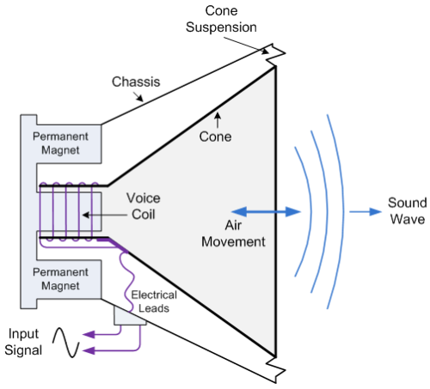
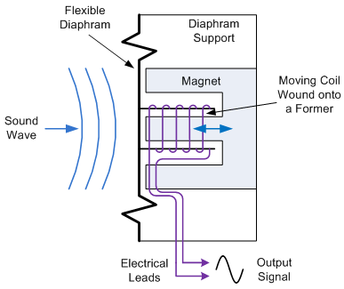
Sound transducers
microphone
speaker
Note: voice coil can also be used to generate fast motion

Slide 18
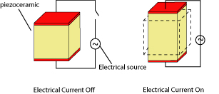
Piezo transducers
Detect motion (high and low frequency)
Sound (lab this week), pressure, fast motion
Cheap, reliable but has a very limited range of motion

Slide 19
Summary
We’ve only briefly touched on most basic types
Many other transducers are used/common, almost for any physical quantity one can think of
Processing electronics is often essential: output of many sensors is not linear, needs impedance transform, filtering, etc.
For additional references see
  http://www.electronics-tutorials.ws/io/io_1.html
  Handbook of Transducers by H.N. Norton
  http://www.sparkfun.com

