Slide 1
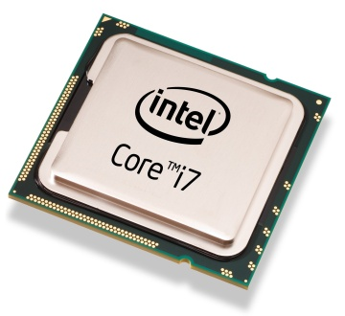
Computers and Microprocessors
Lecture 34
PHYS3360/AEP3630

Slide 2
Contents
Computer architecture / experiment control
Microprocessor organization
Basic computer components
Memory modes for x86 series of microprocessors

Slide 3
Laboratory computers
Many experiments utilize computers interfaced to the physical world via transducers (previous lecture)
This allows control of experiment conditions and data acquisition not otherwise possible (e.g. nonlinear control of a measured parameter, various feedback/readout loops, setup procedures)
Computers can be either standalone or embedded (sometimes also called controllers)

Slide 4
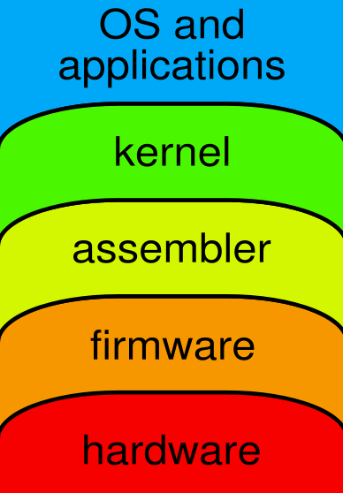
Computer Abstraction Layers
Basic Computer Organization
Has several abstraction layers that hide implementation details
OS & applications: a gateway for human interaction
kernel: mandatory part of OS common to all software; CPU tasks, memory, I/O interrupts; drivers for various devices
assembler: turns assembly language instr. into opcodes (binary stream of commands that CPU understands)

Slide 5
Computer Abstraction Layers (2)
firmware: a low-level program embedded into a hardware that enables its functionality; hardware specific.
Ex: Basic Input/Output System
Microcode
hardware: microprocessors, buses, memory, input/output devices, ports, etc.

Slide 6
Computer Organization
control unit (CU): controls operation timing / sequencing
arithmetic logic unit (ALU): performs all math & logic operations, receives command sequence from CU
clock: synchronizes CPU operation

Slide 7
Central Processing Unit (CPU)
CPU = ALU + CU + registers
Registers: arrays of D flip-flops for storage of operands, addresses, and instructions, characterized by quick access
Microprocessor: CPU on a single chip
general
registers
addressing
control
bus
interface
unit
data bus
ALU
control & timing
address bus
control bus
timing
interrupt requests

Slide 8
Buses
Bus: a group of wires that transfer data from one part to another (data, address, control)
Data bus:
bi-directional (read/write)
8, 16, 32-bit wide common (same as ‘word size’)
Address bus:
specifies memory location in RAM/ROM/interface device to be accessed; monodirectional
address space: 16-bit wide ⇒ 2¹⁶ = 64×2¹⁰ = 64KB
32-bit wide ⇒ 2³² = 4GB
Control bus: carries commands from the CPU and returns status signals from the devices

Slide 9
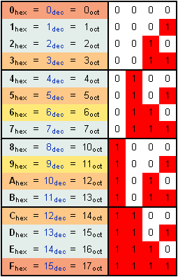
Hexadecimal
Representing data, addresses, or instructions in a computer is more natural using hexadecimal (base-16) notation:
Ex: 16-bit word
1101 0011 1111 0101
D 3 F 5
2
H

Slide 10
Clock
all CPU and bus operations are synchronized to the clock
machine cycle (clock) measures time for a single operation
e.g. 2 GHz → clock cycle 0.5 ns
CPU frequency is not necessarily indicative of the execution speed; e.g. floating pt. operation of multiplication may take ~10 to ~100 cycles depending on the processor
FLOPS: floating operations per second, a useful measure for (super)computers dedicated to extensive computations

Slide 11
Instruction execution cycle
program counter
instruction queue
Fetch
Decode
Fetch operands
Execute
Store output

Slide 12
Simple microcomputer
DATA BUS
IR
ACC
B
I/O
PORT
MEMORY
I/O
DEVICE
DECODE
PC
ALU
I/O
DEVICE
FLAG
CONTROL
AND
SEQUENCING
ADDRESS BUS
CONTROL BUS
CLOCK
Notes:
ACC – accumulator register
IR – instruction register
PC – program counter

Slide 13
Control signals (e.g. 20 in total)
WR
RD
WR
RD
DATA BUS
RD
I/O
PORT
IR
ACC
B
MEMORY
WR
WR
INC
RD
RD
I/O
DEVICE
DECODE
PC
ALU
OP
RD
I/O
DEVICE
FLAG
CONTROL
AND
SEQUENCING
OP
WR
ADDRESS BUS
WR
RD
WR
RD
CONTROL BUS
CLOCK

Slide 14
Example of execution sequence
LDA – assembler mnemonic for ‘load accumulator register’, e.g. for performing arithmetic operation, etc.

Slide 15
LDA (execution cycle 1): IR_{RD}
DATA BUS
RD
I/O
PORT
IR
ACC
B
MEMORY
I/O
DEVICE
DECODE
PC
ALU
I/O
DEVICE
FLAG
CONTROL
AND
SEQUENCING
ADDRESS BUS
CONTROL BUS
CLOCK

Slide 16
LDA (execution cycle 2): MEM_{RD}
DATA BUS
IR
ACC
B
I/O
PORT
MEMORY
I/O
DEVICE
DECODE
PC
ALU
I/O
DEVICE
FLAG
CONTROL
AND
SEQUENCING
ADDRESS BUS
RD
CONTROL BUS
CLOCK

Slide 17
LDA (execution cycle 3): ACC_{WR}
WR
DATA BUS
IR
ACC
B
I/O
PORT
MEMORY
I/O
DEVICE
DECODE
PC
ALU
I/O
DEVICE
FLAG
CONTROL
AND
SEQUENCING
ADDRESS BUS
CONTROL BUS
CLOCK

Slide 18
Example of execution sequence
ADD – adds a number (ALU function) to one already stored in ACC

Slide 19
ADD (execution cycle 1): IR_{RD}
DATA BUS
RD
I/O
PORT
IR
ACC
B
MEMORY
I/O
DEVICE
DECODE
PC
ALU
I/O
DEVICE
FLAG
CONTROL
AND
SEQUENCING
ADDRESS BUS
CONTROL BUS
CLOCK

Slide 20
ADD (execution cycle 2): MEM_{RD}
DATA BUS
IR
ACC
B
I/O
PORT
MEMORY
I/O
DEVICE
DECODE
PC
ALU
I/O
DEVICE
FLAG
CONTROL
AND
SEQUENCING
ADDRESS BUS
RD
CONTROL BUS
CLOCK

Slide 21
ADD (execution cycle 3): B_{WR}
WR
DATA BUS
IR
ACC
B
I/O
PORT
MEMORY
I/O
DEVICE
DECODE
PC
ALU
I/O
DEVICE
FLAG
CONTROL
AND
SEQUENCING
ADDRESS BUS
RD
CONTROL BUS
CLOCK

Slide 22
ADD (execution cycle 4): ALU₁₀, ACC_{WR}
WR
DATA BUS
IR
ACC
B
I/O
PORT
MEMORY
I/O
DEVICE
DECODE
PC
ALU
I/O
DEVICE
FLAG
CONTROL
AND
SEQUENCING
ADDRESS BUS
RD
CONTROL BUS
CLOCK

Slide 23
Example of execution sequence
JMP – jump to another command (aka GOTO)

Slide 24
JMP (execution cycle 1): IR_{RD}
DATA BUS
RD
I/O
PORT
IR
ACC
B
MEMORY
I/O
DEVICE
DECODE
PC
ALU
I/O
DEVICE
FLAG
CONTROL
AND
SEQUENCING
ADDRESS BUS
CONTROL BUS
CLOCK

Slide 25
JMP (execution cycle 2): PC_{WR}
DATA BUS
IR
ACC
B
I/O
PORT
MEMORY
WR
I/O
DEVICE
DECODE
PC
ALU
I/O
DEVICE
FLAG
CONTROL
AND
SEQUENCING
ADDRESS BUS
CONTROL BUS
CLOCK

Slide 26
Intel Architecture 32 (IA-32)
Instruction set for CPUs from 386 to the latest 32-bit processor, also known as x86-32
From programmer’s point of view, IA-32 has not changed all that much except for the introduction of high-performance instructions
Now being succeeded by IA-64 and AMD-64 (but not everything needs a bleeding-edge speed, memory, etc. so many applications / embedded controllers are just fine with 32-bit, 16-bit or even 8-bit processors)

Slide 27
Basic hardware constituents
Chassis
Controller board / Motherboard
Peripheries: video, disk, etc. optional
Memory
I/O ports

Slide 28
Motherboard / controller board
CPU socket
External cache memory slots
Main memory slots
BIOS chips
Video/sound synthesizer chip (optional)
I/O ports and bus standards:
Integrated Drive Electronics (IDE), parallel, serial, Universal Serial Bus, (video, keyboard, network, and mouse connectors)
Peripheral Component Interconnect bus connectors (expansion cards)
Other bus standards such as VMEbus

Slide 29
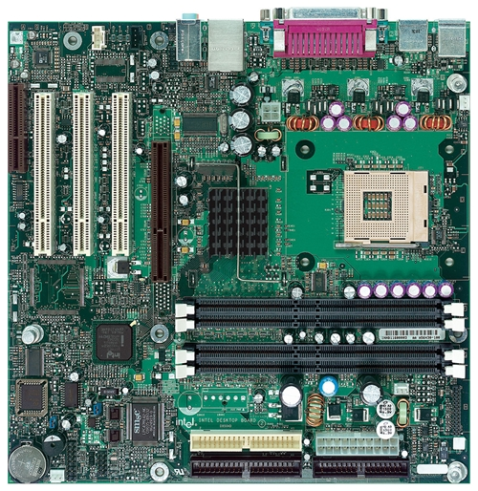
Intel D850MD Motherboard
Video
mouse, keyboard, parallel, serial, and USB connectors
Audio chip
PCI slots
memory controller hub
AGP slot
Intel 486 socket
dynamic RAM
Firmware hub
I/O Controller
Speaker
Power connector
Battery
Diskette connector
Source: Intel® Desktop Board D850MD/D850MV Technical Product Specification
IDE drive connectors
Notes:
AGP - accelerated graphics port

Slide 30
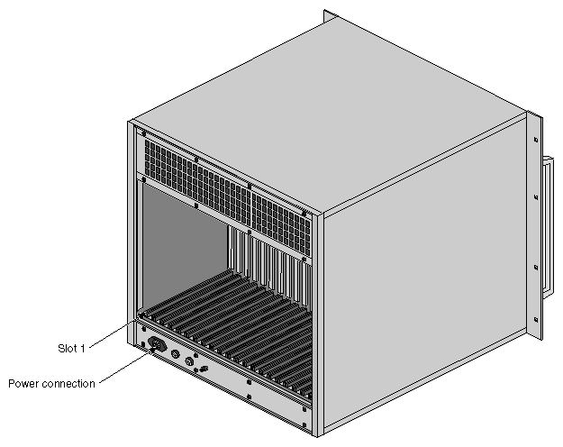
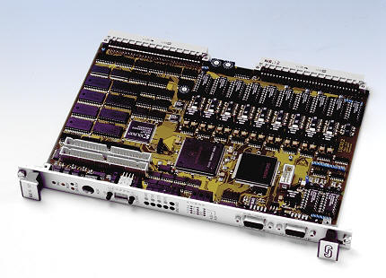
VME Controller Board & Chassis
Notes:
VME – versa module Europa

Slide 31
Memory
Dynamic RAM (DRAM)
stores each bit of data on tiny capacitors on IC
inexpensive, but must be refreshed constantly
Static RAM (SRAM)
uses RS or JK latches
expensive; used for cache memory; no refresh required
Video RAM (VRAM)
dual ported (multiple read/writes occurring at the same time); optimized for constant video refresh
CMOS RAM
refreshed by a battery
system setup information

Slide 32
Reading from memory
Multiple machine cycles are required when reading from memory, because it responds much more slowly than the CPU. The steps are:
address placed on address bus
Read Line (RD) set low
CPU waits one cycle for memory to respond
Read Line (RD) goes to 1, indicating that the data is on the data bus

Slide 33
Cache memory
High-speed expensive static RAM both inside and outside the CPU.
Level-1 cache: inside the CPU
Level-2 cache: outside the CPU
Cache hit: when data to be read is already in cache memory
Cache miss: when data to be read is not in cache memory
Main design problem: minimize cache misses at a reasonable cost (compulsory, capacity, conflict)

Slide 34
Memory access: real mode
1 MB RAM maximum addressable (20-bit address)
Application programs can access any area of memory
Early μ-processors; single tasking; supported by MS-DOS operating system

Slide 35
Memory access: protected mode
4 GB addressable RAM (32-bit address)
(00000000 to FFFFFFFF_{H})
Each program assigned a memory partition which is protected from other programs
Designed for multitasking; supported by Linux & Windows

Slide 36
Multi-segment model
Each program has a local descriptor table (LDT)
holds descriptor for each segment used by the program
multiplied by
1000h

Slide 37
Labs this week
Learn about CPU operations by inspecting a simple assembler program execution
Control USB device with digital inputs/outputs (C++ code with National Instruments driver for Windows XP/Vista)
LTspice experiment: encryption/decryption of digital information using a pseudo-random number generator

