Slide 1
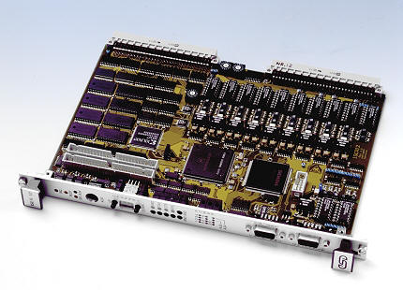
Computers and Microprocessors
Lecture 35
PHYS3360/AEP3630

Slide 2
Contents
Input/output standards
Microprocessor evolution
Computer languages & operating systems
Information encryption/decryption

Slide 3
Input/Output Ports
USB (universal serial bus)
intelligent high-speed connection to devices
up to 480 Mbit/s (USB 2.0 Hi-Speed)
USB hub connects multiple devices
enumeration: computer queries devices
supports hot swapping, hot plugging
Parallel
short cable, Enhanced PP up to 2 Mbit/s
common for printers, simpler devices
bidirectional, parallel data transfer (IEEE 1284)
Intel 8255 controller chip

Slide 4
Input/Output Ports (2)
Serial
one bit at a time
RS-232 (recommended standard 232) serial port
used with long cables (not longer than ~15 m OK)
low speeds (up to 115 kbit/s)
still widely used to interface instruments
additional standards available:
E.g. RS-422/485 differential signals for better noise immunity, can support speeds in access of 10 Mbit/s (becomes cable-length dependent)
Notes:
GPIB – general purpose interface bus

Slide 5
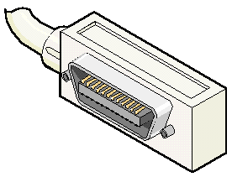
Input/Output Ports (3)
IEEE-488 (GPIB)
Has been around for 30 years, many instruments are equipped with it
Allows daisy-chaining up to 15 devices
Updated versions have speeds up to 10Mbit/s
Notes:
GPIB – general purpose interface bus

Slide 6
Microprocessor Evolution
Generally characterized by the “word” size (registers and data bus)
8-bit, 16-bit, 32-bit, 64-bit
addressable memory related to the word size
Intel 8080 (1974)
8-bit, first truly usable μ−processor (40 DIP)
seven 8-bit registers (six of which can be combined as three 16-bit registers)
6K transistors, 2MHz clock
Other notable 8-bit processors include Zilog Z80 (1976) (used in Osborne 1, first portable μ-computer) and Motorola 6800/6809 (1978)
Small cost, compact packaging allowed home computer revolution

Slide 7
Early Intel Processors
Intel 8080 later variants
64K addressable RAM (16-bit bus address)
8-bit registers
CP/M (control program for μ−computers) OS
5,6,8,10 MHz
29K transistors
Intel 8086/8088 (1978)
16-bit processor, IBM-PC used 8088
1 MB addressable RAM (20-bit addresses)
16-bit registers
16-bit data bus (8-bit for 8088)
separate floating-point unit (8087)
used in low-cost microcontrollers now

Slide 8
Other 16-bit processors
Western Design Center (WDC 65816)
used in Apple II and Super Nintendo
fully CMOS, low power consumption (300 μA at 1MHz, operating voltage as low as 1.8V)
Wait-for-Interrupt and Stop-the-Clock instructions further reduce power consumption
one of the most popular (made in huge numbers)
Still sold today (original 1984), used as a controller
24-bit address bus (16MB of memory space)
Texas Instrument TM9900, National Semiconductor IMP-16, etc.

Slide 9
IBM-AT
Intel 80286 (1982)
Still largely a 16-bit processor
16 MB addressable RAM
Protected memory
several times faster than 8086
introduced IDE bus architecture
80287 floating point unit
Up to 20MHz
134K transistors

Slide 10
32-bit processors
Motorola 680x0 series
32-bit registers
68010 (1982) adds virtual memory support
Other successors 68020/68030/68040/68060
Popular with UNIX operating systems in late 1980’s/early 1990’s
Faded from computer desktop market, but had a strong standing in embedded / controller equipment (still used)
“Microprocessor wars”
leads to elimination of some / survival of the fittest. In aftermath, the PC market to be largely dominated by IA-32; however, much more diversity exists for the controllers

Slide 11
IA-32
Intel386 (1985)
4 GB addressable RAM
32-bit registers
paging (virtual memory)
Up to 33MHz
Intel486 (1989)
instruction pipelining
Integrated FPU
8K cache
Pentium (1993)
Superscalar (two parallel pipelines)
Intel declines to license Pentium to others, AMD and Cyrix start their own designs
Notes:
FPU – floating point unit

Slide 12
Intel Pentium Family
Pentium Pro (1995)
advanced optimization techniques in μ-code
More pipeline stages
On-board L2 cache
Pentium II (1997)
MMX (multimedia) instruction set
Up to 450MHz
Pentium III (1999)
SIMD (streaming extensions) instructions (SSE)
Up to 1+GHz
Pentium 4 (2000)
NetBurst micro-architecture, tuned for multimedia
3.8+GHz
Pentium D (Dual core)
…
Notes:
SIMD – single instruction multiple data

Slide 13
Some interesting statistics
2003 data (from Wikipedia)
$44 billion dealt in business on microprocessors
Personal computers account for 50% of cost but only 0.2% of all CPU’s sold
55% of all CPU’s sold are 8-bit controllers (many billions sold overall)
Less than 10% of all CPU’s are 32-bit or more
Of all 32-bit processors sold, only 2% are used in personal computers (laptops/desktops)
“Taken as a whole, the average price for microprocessor, microcontroller, or DSP is just over $6”
Read more at http://www.embedded.com/shared/printableArticle.jhtml?articleID=9900861

Slide 14
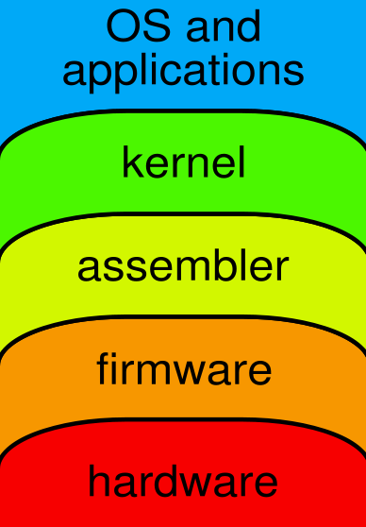
Programming
Interpreted High Level Language
Compiled High Level Language
Assembly Language
Machine Language

Slide 15
Programming (2)
Machine Language
binary instructions (op codes) actually read and interpreted by the CPU
Ex: 1000 1011 0000 0101
‘move value from memory to AX register’ on 386
different for each CPU type
Assembly Language
CPU instructions represented by mnemonics
Ex: MOV AX, M same as above
each AL instruction converts to one ML instruction by assembler program
Efficient fast execution, inconvenient to program in
Allows access to instructions not available with higher level language

Slide 16
Programming (3)
High Level Language, e.g. C/C++
easier to use
it’s compiler’s job to translates (one) HLL instruction into (many) ML instructions
portable: can compile the same source (HLL instructions) on different OS platforms
slower and more restricted
Interpreted Languages, e.g. JAVA, scripting
on-the-fly translation of high level language
slowest of the above, but often a good place to start with a new project

Slide 17
μ-processor: registers
Storage locations inside the CPU, optimized for speed.
32-bit General-Purpose Registers
EAX
EBP
EBX
ESP
ECX
ESI
EDX
EDI
Control registers
16-bit Segment Registers
EFLAGS
CS
ES
SS
FS
EIP
DS
GS

Slide 18
μ-processor: registers (2)
General Purpose Registers: used to contain arithmetic and logical operands used by ALU
Segment Registers: indicate segments of memory currently in use.
CS: (code segment) memory segment where instructions/program are located
DS: (data segment) …
SS: (stack segment) …
ES: (extra segment) …
Pointer & Index Registers:
BP: base pointer
SP: stack pointer
SI: source index
DI: destination index
complete address = segment + pointer/index
Notes:
Stack – set of memory locations in RAM used for temporary storage of micro-processor registers, intermediate results, etc.

Slide 19
μ-processor: registers (3)
Control Registers:
IP/IR: instruction pointer held in instruction register (memory address of next instruction to be executed)
FLAGS: status and control flags; used to indicate processor status
o
i
s
z
p
c
11 10 9 8 7 6 5 4 3 2 1 0
c = 1: if operand produced carry
p = 1: if operand has parity of 1
z = 1: if result = 0
s = 1: if result < 0
i = 1: μ-processor will respond to interrupts
o = 1: if result produced overflow

Slide 20
μ-processor instruction cycle
Fetch the next instruction (address is held in instruction pointer / register); instruction pointer is incremented to the next value or branched, conditional statements may throw it elsewhere
Decode: what do 1’s and 0’s mean?
Execute: the instruction

Slide 21
some basic assembler instructions
Data Transfer:
MOV d,s move (s)ource to (d)estination
Arithmetic:
ADD d,s add s to d and store it in d
INC d increment contents of d by 1
Logical and Shifts:
AND d,s bitwise AND of s with d, store in d
SHL d shift d left one bit
Control Transfer:
JMP loc jump to memory location loc
JE loc jump to loc if result of last operation = 0
I/O:
OUT d,s output to the I/O space (address d)

Slide 22
Addressing modes
Location of the operand of an instruction may be obtained:
Immediate: e.g. 200 (hex!)
Operand contained in 2nd part of the instruction
Register: e.g. BX
Operand is contained in one of the general registers
Indirect: e.g. [200]
Operand’s address is contained in the 2nd part of the instr.
Register indirect: e.g. [BX]
Operand’s address is contained in one of the general pointers or pointer/index registers
Indexed: e.g. [BX+1]
Operand’s address is formed by adding displacement contained in 2nd part of the instr. to the contents of one of the index registers

Slide 23
Assembler example
Addr. ML AL Meaning
opcode
lo
hi
100 BB 00 02 MOV BX,200 BX ← 200h (load addr.)
103 8A 2F MOV CH,[BX] CH ← value at loc 200h
105 8A 4F 01 MOV CL,[BX+1] CL ← value at loc 201h
108 88 0F MOV [BX],CL loc 200h ← CL
10A 88 6F 01 MOV [BX+1],CH loc 201h ← CH
10D CD 20 INT 20 software interrupt (exit)
Location Value before Value after
200 A1 B2
201 B2 A1
202 ? ?
The program swaps values in locations 200 and 201

Slide 24
Input/Outputs
I/O devices usually have their own registers which are assigned or mapped to addresses in memory
I/O is achieved by μ-processor reading from / writing to the corresponding memory addresses
Ex: I/O user port used in the lab this week has 8 registers at addresses 2A0_{H} → 2A7_{H}. Used to control ADC, DAC and digital I/O functions of the port.

Slide 25
Operating System
Provides a level of abstraction and security for higher level applications; interrupts, memory handling, etc.
I/O are privileged operations, usually only OS can do I/O
A device driver is provided, which runs as part of the OS
User’s program then communicates to the device through the driver and OS

Slide 26
OS: multitasking
Most OS can run multiple programs at the same time.
Multiple threads of execution within the same program.
Scheduler utility assigns a given amount of CPU time to each running program.
Rapid switching of tasks gives illusion that all programs are running at once
The processor must support task switching
Scheduling policy, priority, etc.

Slide 27
Interrupts
Used for handling peripheral I/O asynchronously (orders of magnitude differences in time required for access, enable/disable, read/write, etc.)
Device requiring services asserts Interrupt Request.
When INTR asserted:
μ-processor completes execution of current instruction
IP/IR & other registers pushed onto stack
IP/IR loaded with address of interrupt routine
interrupt routine executed to identify and service the device
when completed, IP & registers popped from stack, and program execution resumes

Slide 28
Real Time Operating Systems
General purpose OS systems such as Linux, Windows, Mac OS do not guarantee ‘real-time’ execution of instructions
i.e. they don’t necessarily have any operational deadlines from event to system response
e.g. various interrupts, multitasking, etc. are usually handled with the illusion of smooth running for a casual user, but the behavior is not deterministic
Multitasking operating systems are available that provide tools to ensure that certain deadlines from event to system response are met.
Examples: VxWorks (Wind River) – used on Mars rovers RTLinux, RTEMS (o.source)

Slide 29
LTspice experiment 11.1
Signal encryption using a sequence of pseudo-random numbers
Uses linear feedback shift registers (LFSR) to generate a sequence of pseudo-random numbers (deterministic sequence that looks random)
If LFSR has N bits, the max sequence will be 2^{N} – 1 long, then repeats
E.g. 8-bit LFSR can produce 255 long sequence, 32-bit LFSR can produce 4,294,967,295 pseudo-random sequence
XOR gates are used to tap certain outputs into the serial input (see the table in the Supplement)

Slide 30
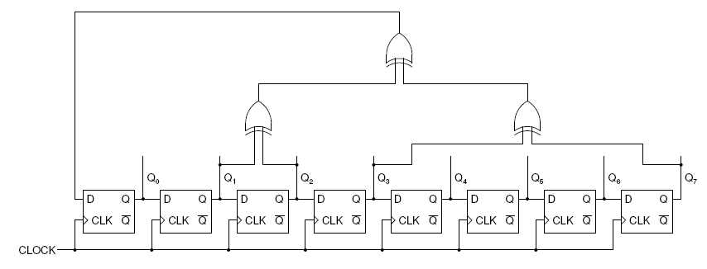
Pseudo-random number generator
8-bit pseudo-random generator
Output random number is (Q₇Q₆Q₅Q₄Q₃Q₂Q₁Q₀)₂
At least one Q_{i} bit must be non-zero initially for non-trivial (other than always 0’s) pattern
The initial state of Q_{i} bits is known as seed, which uniquely defines the sequence of pseudo-random numbers

Slide 31
Encrypting/decrypting
To encrypt scramble the stream of data bits with pseudo-random sequence:
EN_{i} = A_{i} ⊕ PR_{i}
encrypted bit
P-random bit
Information bit
How to decrypt?
A_{i} = EN_{i} ⊕ PR_{i}
Need the same unique sequence of pseudo-random numbers used for encryption (seed becomes encryption/decryption password).

Slide 32
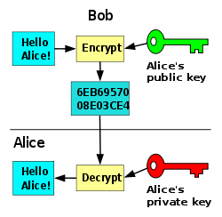
LTspice experiment 11.1
Implement pseudo-random number generator
Decrypt an encrypted 8-bit data stream
Perform digital-to-analog conversion and plot a parametric curve (x(t), y(t)) to display the secret message
E.g. explain how RSA encryption/decryption works
RSA = Rivest, Shamir, Adleman
Public key cryptography
Things to read/think about

Slide 33
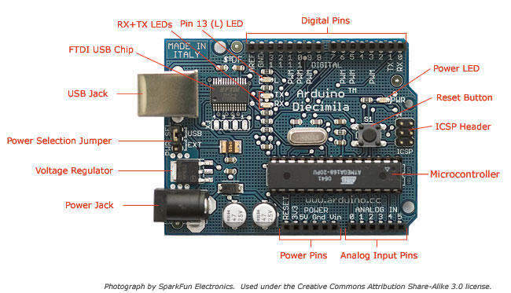
Arduino – 30$ computer (Teensy – 19$)
www.arduino.cc
QCO
Arduino Uno specs
Microcontroller ATmega328
Operating Voltage 5V
Input Voltage (recommended) 7-12V
Input Voltage (limits) 6-20V
Digital I/O Pins 14 (of which 6 provide PWM output)
Analog Input Pins 6
DC Current per I/O Pin 40 mA
DC Current for 3.3V Pin 50 mA
Flash Memory 32 KB (ATmega328) of which 0.5 KB used by bootloader
SRAM 2 KB (ATmega328)
EEPROM 1 KB (ATmega328)
Clock Frequency 16 MHz

Slide 34
Different Arduinos
Arduino Mega Arduino UNO Arduino Mini/Nano Lilypad

